Slide 1



Snapshot of the Equipment Leasing and Finance Industry and U.S. Economy
December 2024
Prepared For:
Equipment Leasing & Finance Foundation
Prepared By:
Keybridge LLC

Slide 2
Data: Table of Contents
1. Overall Economy
p. 3
2. Investment
p. 9
3. Business Health
p. 12

Slide 3

The U.S. economy expanded at 2.8% (SAAR) in the third quarter of 2024, a slight decrease from 3.0% growth in Q2 2024.
Economy
Real GDP Growth
Annualized % Change from Prior Quarter
Forecast
30-Year Quarterly Average = 2.6%
2.8%
-29.9%
Source: U.S. Bureau of Economic Analysis, Keybridge LLC
Notes:
The U.S. economy expanded at a solid 2.8% annualized rate in Q3, the second consecutive quarter of healthy growth.
Three key factors have boosted the U.S. economy in 2024 and set the stage for continued economic growth in 2025: a strong labor market, rising household wealth, and remarkably resilient consumer spending.
Looking ahead, consumers and businesses alike are feeling more optimistic about their prospects in 2025. The stock market has similarly been up since the election in anticipation of lower taxes and less regulation, which means that household wealth should continue to rise and encourage consumer spending. Still, the policy landscape under a new administration and unified Congress is uncertain, and tariffs, taxes, and industrial policy will be key factors to watch.

Slide 4
Q3 growth was primarily driven by consumer spending, supported by a boost in government spending and business investment.
Economy
Tailwinds & Headwinds
Contributions to GDP growth by sector
TAILWINDS
HEADWINDS
Change in Private Inventories (-0.11)
[+3.72]
[-0.89]
+0.52
Residential Investment (-0.21)
Business Investment
-0.57
Government Spending
+0.83
Net Exports
NET CHANGE
IN GDP
+2.8
+2.37
Consumer Spending
Source: U.S. Bureau of Economic Analysis, Keybridge LLC
Notes:
Economists often use a simple formula to describe the U.S. economy: “C + I + G + NX” (consumption + investment + government spending + net exports). The primary drivers of Q3’s expansion were consumer spending, government spending, and business investment. Net exports, residential investment, and private inventories contributed negatively to GDP growth.
Consumer spending expanded 3.5% (annualized) in Q3. Spending on services grew 2.6%, essentially unchanged from Q2, but spending on goods strengthened significantly to 5.6%, with both durable goods (+7.6%) and nondurable goods (+4.6%) posting strong gains.
Government spending picked up again in Q3 (5.0% annualized), mostly due to robust 13.9% growth in federal defense spending.
Equipment investment (separate from software investment) rose a strong 10.6% (annualized), led by strong demand for aircraft equipment (which has more than doubled over the last two quarters) and information processing equipment. Industrial equipment expanded modestly after contracting slightly in Q2.
Resident investment fell 5.0% (annualized), its second consecutive negative quarter. While lower interest rates could spur demand for housing construction in 2025, construction employment growth has slowed in recent months and could be a key wildcard in 2025.

Slide 5

Special Topic: Trump’s Second Term – Tariffs
Modest tariffs may have little effect, but an aggressive tariff regime would harm growth
Tariffs as an Economic Strategy
Following the election, President-elect Trump has proposed 25% tariffs on Mexico and Canada and a 100% tariff on Brazil, India, Russia, China, and South Africa (BRICS nations).
Though some domestic industries may benefit from tariffs (e.g., steel manufacturing), most economists argue that tariffs distort markets, harm U.S. consumers, and lead to retaliatory measures that harm U.S. exporters.
Economic Consequences and Retaliation
While Recent proposals may be more about “setting a tone” and framing future negotiations, not a forgone conclusion. Broad-based tariffs on Chinese imports are highly likely, and tariffs on other trading partners are in play.
U.S. imposed tariffs and retaliatory tariffs from trading partners would likely increase the cost of equipment and may have unpredictable effects on global supply chains.
Uncertainty and Opportunities
  Even if significant tariffs are not implemented, the “will they or won’t they” negotiating tactic creates uncertainty for businesses that could prove a headwind for investment in the near term.
  At the same time, domestic manufacturers of tariff-impacted imports are likely to benefit, creating opportunities for equipment finance firms that serve this part of the market.
Source: 2025 Annual Equipment Leasing & Finance U.S. Economic Outlook
Notes:
Trump’s Second Term – Tariffs
Tariffs in Trump’s First Term –
Trump imposed broad-based tariffs on all Chinese imports and additional, targeted tariffs on specific goods such as aluminum, steel, washing machines, and solar panels.
Real-World Impact of the 2018 Tariffs –
Revenue: Tariffs generated roughly $80 billion in revenue in 2023. The Tax Policy Center estimates that a 10% tariff on all imported goods and a 60% tariff on Chinese imports would raise around $280 billion per year on net, equivalent to ~7% of tax proceeds.
Trade balance: The U.S. trade deficit for goods was -$73.6 billion when the tariffs were first implemented in January 2018. By the end of 2019, the trade deficit had narrowed slightly to -$68.5 billion but then ballooned to -$83.4 billion in 2020, fueled by pandemic consumption.
Consumer impact: According to the Tax Foundation, tariff-related price increases imposed the equivalent of a $200-300 tax increase on U.S. consumers.
U.S. employment: While some domestic industries such as steel manufacturing have benefitted from tariffs, researchers from the Federal Reserve Board concluded the U.S. manufacturing employment fell -1.4% on net, as import protections were more than offset by rising input costs and retaliatory tariffs from U.S. trade partners.
Tariffs in President Trump’s Second Term –
While recent proposals may be more about “setting a tone” and framing future negotiations, it is not a forgone conclusion. Broad-based tariffs on Chinese imports are highly likely, and tariffs on other trading partners are in play.
U.S. imposed tariffs and retaliatory tariffs from trading partners would likely increase the cost of equipment and may have unpredictable effects on global supply chains.
The “will they or won’t they” negotiating tactic creates uncertainty and stress for US businesses, many of whom have near shored to Mexico and Canada since the pandemic.
Domestic manufacturers of tariff-impacted imports are likely to benefit, creating opportunities for equipment finance firms that serve this part of the market.

Slide 6
Special Topic: Trump’s Second Term – Taxes
The equipment finance industry should benefit from the extension of key tax provisions
The 2017 Tax Cuts and Jobs Act
With many provisions of the 2017 Tax Cuts and Jobs Act set to expire at the end of 2025, Washington is gearing up for a historic tax year.
The TCJA’s corporate tax provisions resulted in an 8%-14% increase in corporate investment, a ~1% rise in real wages from corporate savings, and a ~0.1% boost in annual GDP growth.
The Impact of New Legislation on Investment
With a Republican-controlled Congress and Presidency, there is reason to be optimistic that the final tax package will be favorable to businesses, including equipment finance firms.
For example, if full bonus depreciation is reinstated, which began to phase out in 2023, capital investments could accelerate, especially among smaller firms.
Similarly, if the corporate tax rate is lowered to 15% for U.S. manufacturers, this could provide a near-term investment boost for industrial equipment.
Potential Long-Term Implications
  President Trump’s tax and spending priorities are expected to add ~$8 trillion to the federal debt over the next decade.
  With the debt-to-GDP ratio is already above 100% and rising, economists warn of the long-term risks to the country’s fiscal health.
  Future taxpayers may bear the burden of increased debt, but in the current political climate neither party appears interested in confronting this risk. This appears unlikely to change unless (or until) markets force them to do so.
Source: 2025 Annual Equipment Leasing & Finance U.S. Economic Outlook
Notes:
Trump’s Second Term – Taxes
Individual TCJA Provisions Set to Expire –
Lower marginal tax rates
Higher standard deductions for individuals,
Caps on state and local tax deductions
Higher child tax credits
Higher estate tax exemption
Business TCJA Provisions Set to Expire –
Qualified business income deductions for small businesses
Bonus depreciation
Limits on the deductibility of interest payments
Other TCJA Provisions Set to Expire –
Renewable energy tax credits may be eliminated to raise revenue for other purposes (e.g., increasing child tax credit, exempting creation income from taxation, etc.)
“Pay-fors” may not be extended (e.g., requirements to amortize R&D expense deductions and limits on non-corporate business losses)
The Economic Effect of a New Tax Bill –
The final tax package will likely be favorable to businesses, including equipment finance firms.
Provisions like full bonus depreciation and lower corporate tax rates could boost investment.
But economists warn of the long-run effects of rapidly rising federal debt.

Slide 7
Special Topic: Trump’s Second Term – Industrial Policy
Policy priorities are likely to shift, but the effect on equipment demand is unclear.
The Biden administration’s industrial policy has allocated hundreds of billions of dollars in public investment toward renewable energy, domestic manufacturing, and infrastructure development projects.
While these investments have boosted infrastructure and manufacturing construction spending (see Figure 1), less than 17% of funds provided by the IRA, CHIPS Act, IIIJA, and American Rescue Plan had been spent as of mid-2024.
Unobligated remaining funds could be rescinded and tax incentives favoring renewable energy could be repealed to help pay for tax cuts in 2025.
Equipment finance firms focused on clean energy, sustainability, or infrastructure development could be negatively impacted due to the loss of public funds and incentives from these programs, but we expect private markets to continue prioritizing these kinds of investments.
Meanwhile, the Trump Administration’s focus on U.S. energy dominance should benefit the oil and gas industry, though it is worth noting that recent drilling efficiency improvements may reduce the number of active oil rigs necessary to achieve production targets, which could hold back demand for oil mining equipment (see Figure 2).
Figure 1: Real Investment in Manufacturing Structures
Nonresidential, billions of dollars
Figure 2: Domestic Oil Rigs vs Oil Production
Monthly, number of rigs, millions of barrels
Oil Production
IRA and CHIPS Act Signed Aug. 2022
Oil Rigs
Source: Congressional Budget Office, 2024.
Source: U.S. Energy Information Administration; Baker Hughes.
Source: 2025 Annual Equipment Leasing & Finance U.S. Economic Outlook
Notes:
Trump’s Second Term – Industrial Policy
Benefits of Biden’s Industrial Policies
Manufacturing construction and boosted industry growth (e.g., Since late 2019, manufacturing construction investment has increased by 215%, real public infrastructure spending has increased by 9%, etc.)
Incentives from the CHIPS Act are estimated to have created an additional $450 billion in private investments and created 58,000 jobs
Downfalls of Biden’s Industrial Policies
Nearly 40% of new manufacturing investments are delayed, and less than 17% of the $1.1 trillion provided by the IRA, CHIPS Act, IIJA, and American Rescue Plan had been spent as of April 2024
President Trump’s Energy Dominance Policy:
While renewable energy producers may find less support from the Trump Administration than they have over the last four years, the oil and gas industry should benefit from a renewed focus on U.S. energy dominance.
Oil and gas producers are likely to face fewer permitting and regulatory hurdles, which should provide a lift for equipment demand.
At the same time, domestic oil production is already at an all-time high, largely due to improved drilling techniques and AI tools that have dramatically improved drilling output and efficiency. These technological advances are a double-edged sword for equipment manufacturers, however, as producers have increased production levels while reducing the number of active oil rigs.

Slide 8
Projections for Key Economic Indicators
Indicator | 2023 | 2024e | 2025 Quarterly Estimates |  |  |  | 2025e
 |  |  | Q1e | Q2e | Q3e | Q4e
Real GDP (SAAR) | 2.9% | 2.8% | 2.9% | 2.6% | 2.2% | 1.8% | 2.7%
Real Investment in Equipment & Software (SAAR) | 4.8% | 4.8% | 4.0% | 4.4% | 6.6% | 7.8% | 4.7%
Inflation (Headline CPI, Y/Y %, end of period) | 4.1% | 2.9% | 2.3% | 2.6% | 2.6% | 2.7% | 2.7% (end of year)
Federal Funds Target Rate (upper bound, end of period) | 5.50% | 4.50% | 4.50% | 4.25% | 4.00% | 4.00% | 4.00% (end of year)
Non-Farm Payroll Growth (thousands) | 3,013 | 2,146 | 550 | 525 | 475 | 450 | 2,000
Source: 2025 Annual Equipment Leasing & Finance U.S. Economic Outlook
Notes:
GDP: We expect real GDP to grow by 2.7% in 2025, with strong growth in Q1 before moderating in line with a soft landing.
Investment: We expect E&S investment to expand at a 4.7% annualized rate in 2025. Moderate growth is expected during the first half of the year with upside potential later in the year if inflation cools further towards 2% and the Fed responds by further lowering interest rates.
Inflation: We expect CPI headline inflation to remain sticky in 2024, falling in Q1 before ticking up through the rest of the year.
Interest Rates: We expect two additional rate cuts next year. In 2025, FOMC members will be carefully following and evaluating upside risks to inflation and downside risks to employment, including the extent to which the incoming Trump administration pursues broad-based tariffs or large-scale deportations, both of which could put near-term pressure on the economy.
Job Growth: The December employment confirmed that the labor market remains generally healthy, with 227K jobs created in November and upward revisions to the previous two months’ data. Although job growth has slowed and unemployment has risen this year, the labor market remains healthy, as does consumer demand.

Slide 9
Nonresidential fixed investment has expanded for the last 12 quarters, growing 3.8% (SAAR) in Q3 2024.
Investment
Business Investment
Real Nonresidential Fixed Investment, % Change from Prior Quarter
3.8%
-29.4%
-28.5%
Source: U.S. Bureau of Economic Analysis
Notes:
Business investment grew in Q3, rising 3.8% (annualized). Growth contracted slightly from 3.9% in the previous quarter.
Business investment (also known as nonresidential fixed investment) consists of three elements: equipment, software and R&D, and non-residential structures (e.g., commercial buildings, oil platforms).
Equipment: +10.6% (annualized) (up from +9.8% in Q2)
Non-residential structures: -4.7% (annualized) (down from +0.2% in Q2)
Software and R&D: +2.5% (annualized) (up from +0.7% in Q2)

Slide 10
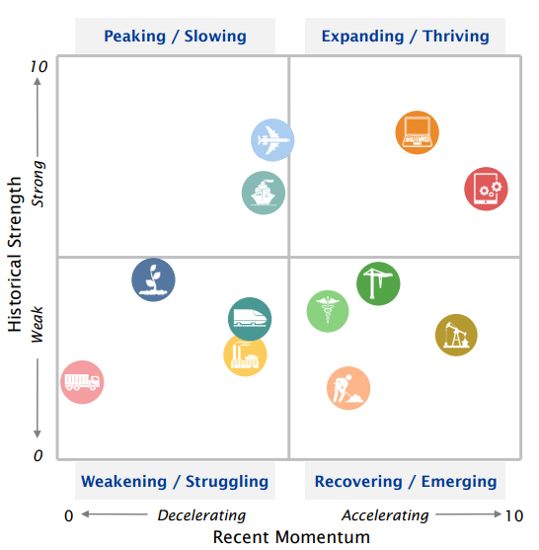
Six of 12 verticals are exhibiting recent momentum that is stronger than historical norms, including Computers and Mining & Oilfield Machinery.
Investment
Equipment & Software Investment Momentum Monitor
Equipment Vertical Performance Matrix
Source: 2025 Annual Equipment Leasing & Finance U.S. Economic Outlook
For more information on how to use the Momentum Monitors, see final slide.
Notes:
Equipment and Software investment expanded 7.5% in Q3 (annualized) after growing by 7.0% in Q2.
Based on the latest data, investment growth in the following equipment verticals appears set to expand in the coming ~6 months:
Computers
Mining & Oil
Based on the latest data, investment growth in the following equipment verticals appears set to shrink in the coming ~6 months:
Other Industrial Equipment
Trucks
Notes about the Equipment Vertical Performance Matrix: The matrix above summarizes the current values of each of the 12 Equipment & Software Investment Momentum Indices based on two factors: Recent Momentum (x-axis) and Historical Strength (y-axis). The matrix is comprised of four quadrants according to each vertical’s “recent momentum” and “historical strength” readings (see last slide in deck for a description of these terms):
If a vertical is located in the top-left quadrant, its momentum reading is higher than average, but positive movement has slowed (and perhaps reversed) in recent months — suggesting that investment growth may worsen over the next 2 quarters.
Verticals located in the bottom-right quadrant, however, have momentum readings that are below average, but recent movement shows promise — suggesting that investment levels may rise over the next 2 quarters. This makes them potentially attractive targets for new leasing and finance opportunities.

Slide 11
After accelerating 7.5% (annualized) in Q3, E&S investment growth is expected to slow in Q4 before expanding moderately in 2025.
Investment
Real Equipment & Software Investment Growth
Q/Q % change, SAAR
Forecast
40.1%
7.5%
-14.0%
-28.3%
Source: U.S. Bureau of Economic Analysis; Projections from Keybridge
Notes:
Equipment and software investment expanded 7.5% in Q3 (annualized) after growing 7.0% in Q2. Growth was positive in seven of 12 tracked verticals, with Aircraft leading for the second consecutive quarter (+421% Q/Q annualized). Mining & Oilfield Machinery and Construction machinery experienced negative investment movement.
The Foundation expects moderate equipment and software investment growth rates during the first half of the year, with more upside potential if inflation resumes its downward path toward 2% and the Fed responds by further lowering interest rates.

Slide 12
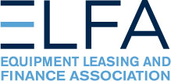
New business volume was up 3.7% year-to-date in October, outpacing the rate of inflation.
Bus. Health
CFI New Business Volume (NBV)
Billions of $
Source: ELFA CapEx Finance Index
*Note: The CFI reports economic activity from 25 companies representing a cross section of the equipment finance sector. It does not represent the total size of the equipment finance industry.
Notes:
According to ELFA’s CapEx Finance Index, new business volume was $10.5 billion in October, up 5.1% from September for the largest monthly gain in more than a year.
Note: The Equipment Leasing and Finance Association’s (ELFA) CapEx Finance Index (CFI), a survey of economic activity from 25 companies representing a cross section of the $1 trillion equipment finance sector

Slide 13
On a nominal basis, new business volume increased nearly 12% year-over-year in October.
Bus. Health
CFI New Business Volume (NBV)
Y/Y % change
11.9%
New business volume is up 3.7% year-to-date
Source: ELFA CapEx Finance Index
*Note: The CFI reports economic activity from 25 companies representing a cross section of the equipment finance sector. It does not represent the total size of the equipment finance industry.
Notes:
According to ELFA’s CapEx Finance Index, new business volume (NBV) totaled $10.5 in October, up 11.9% on a Y/Y basis. Year-to-date, NBV was up 3.7% compared to October 2023.
Portfolio performance remains strong:
Charge-offs declined to 0.31%, their lowest level since January 2023
Receivables over 30 days edged up slightly to 2.2% but remains muted.
Credit approvals ticked down for the second consecutive month to 75.1%, among the lowest readings of the past 18 months but still in line with historical norms.
*Note: ELFA’s CapEx Finance Index reports economic activity from 25 companies representing a cross section of the equipment finance sector.

Slide 14
Equipment finance industry confidence improved to 67.5 in November, its strongest reading in more than three years.
Bus. Health
Monthly Confidence Index: Equipment Finance Industry (MCI-EFI)
67.5
Source: ELFF MCI-EFI
Notes:
In November, the MCI-EFI improved to 67.5, its highest index reading in more than three years. Notably, the survey was in the field during the election, with roughly half of responses submitted prior to the election and the remainder submitted afterward. Relevant survey findings include:
43% of respondents expect near-term business conditions to improve (up from 40% last month), while 7% expect them to worsen (up from 3%).
48% of respondents expect demand for leases and loans to fund capex will increase over the next four months (up from 45%), while 7% expected demand to decline (down from 14%).
38% of respondents expect greater access to capital over the next four months (up from 28%), while no respondent expected credit access to worsen.
60% of respondents expect the U.S. economy to improve over the next six months, up sharply from 38% in October.
Note: The MCI-EFI is produced by the Foundation each month using a survey of key industry executives from banks, captives, and independent firms. It is designed to provide a qualitative assessment of both the prevailing business conditions and expectations for the future.

Slide 15
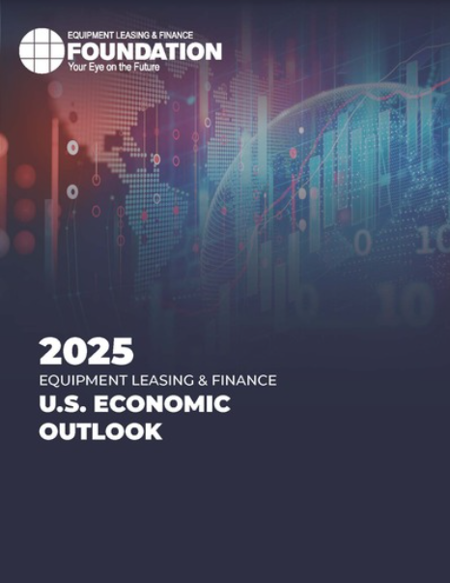
EQUIPMENT LEASING & FINANCE FOUNDATION
The latest edition of the Keybridge / Foundation U.S. Economic Outlook is available here at the Foundation’s website.
Reports are available to download at www.store.leasefoundation.org

Slide 16
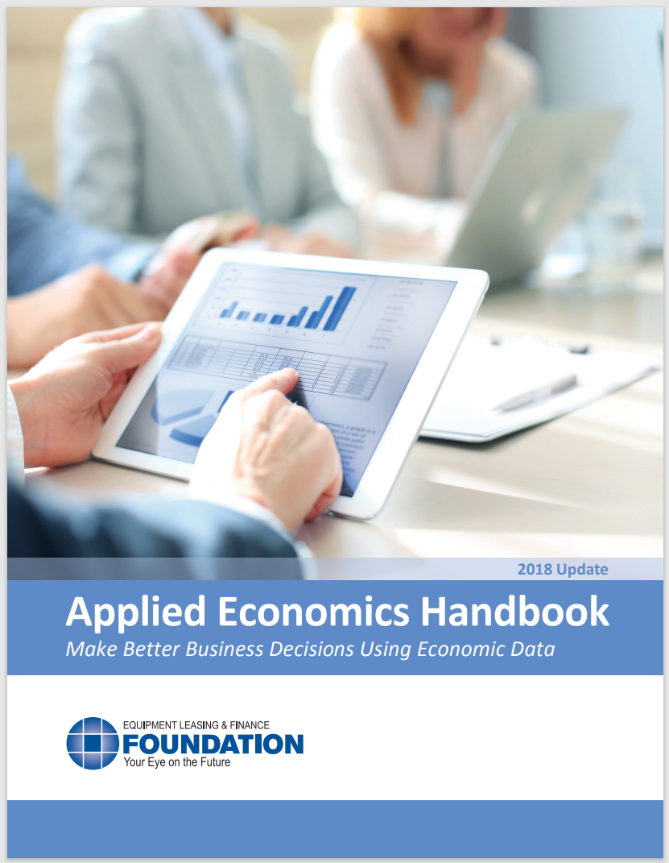
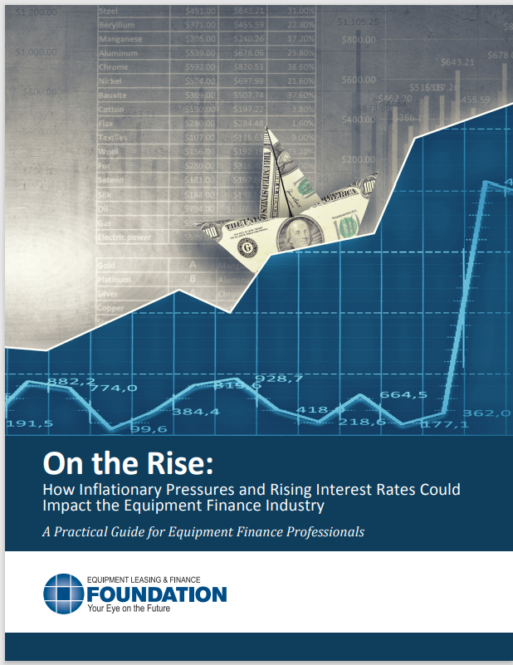
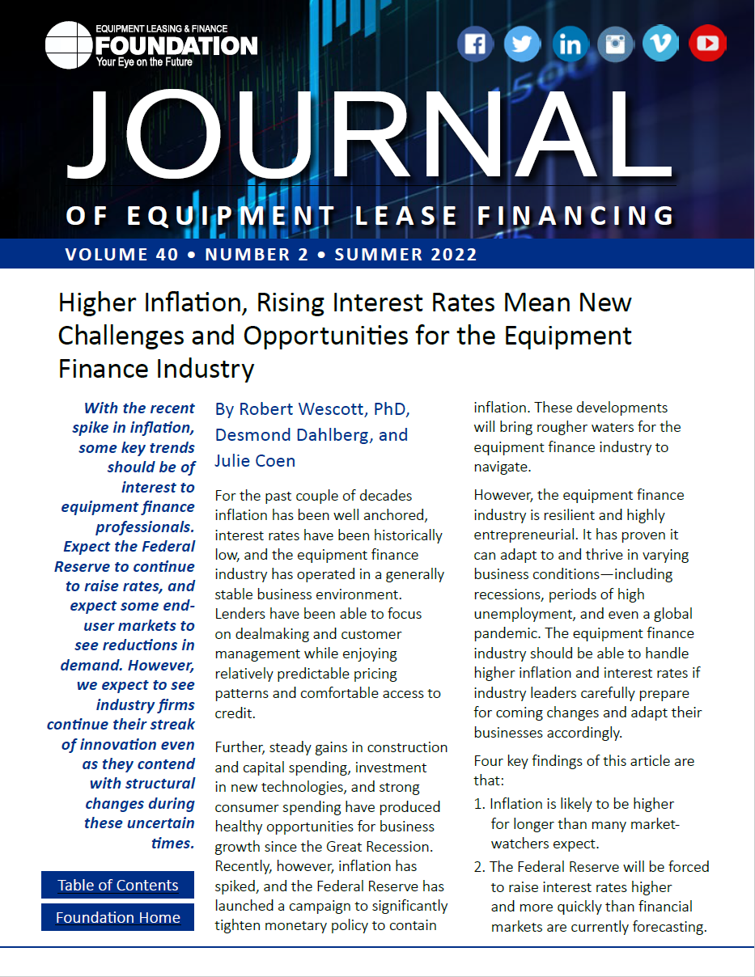
EQUIPMENT LEASING & FINANCE FOUNDATION
For more information, download the Applied Economics Handbook or research articles (2018 & 2022) analyzing the effect of inflation and rising interest rates on the equipment finance industry.

Slide 17
Notes
*U.S. Equipment & Software Investment Momentum Monitor (Slide 10)
Published monthly, the U.S. Equipment & Software Investment Momentum Monitor is a set of leading indicators for the equipment sector consisting of indices for various equipment and software investment verticals. These indices are designed to identify turning points in their respective investment cycles with a ~6-month lead time.
Each index is comprised of ~20 high-frequency indicators and is statistically optimized to signal turning points in the investment cycle without giving false readings of shifts in momentum.
The Momentum Monitor covers 12 equipment and software verticals as defined by the U.S. Department of Commerce Bureau of Economic Analysis. These verticals include aircraft, agriculture machinery, computers, construction machinery, materials handling equipment, medical equipment, mining and oilfield equipment, other industrial equipment, railroad equipment, ships and boats, software, and trucks.
“Recent Momentum" represents the degree of an indicator's recent acceleration or deceleration in the past month relative to its average movement during the previous 3 months. Ratings closer to "0" represent an indicator that is rapidly decelerating, while ratings closer to “10” represent an indicator that is rapidly accelerating.
"Historical Strength" represents the strength or weakness of an indicator in the past month relative to its typical level since 1999. Ratings closer to "0" represent an indicator that is weaker than average, while ratings closer to "10" represent an indicator that is stronger than average.

