Slide 1


FUNDING
In Capital Markets
Notes:
EDITOR NOTE: This deck is intended to be customizable and changeable based on the individual presenters and their career particulars.

Slide 2
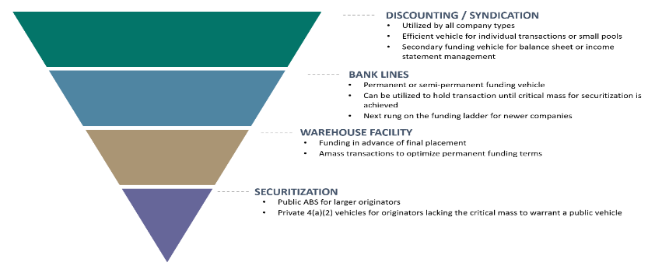
Funding is the Lifeblood of Equipment Finance Companies
Sequencing of Funding Tools
Sources: The Alta Group, LLC, Best Practices in Equipment Finance Funding, Securitization & Syndication for Today and Tomorrow (Equipment Leasing & Finance Foundation, 2022).

Slide 3
Three Capital Markets Activities for Equipment Finance Companies
Capital Markets activity is any type of external funding required to operate an equipment leasing company.
Equipment-Backed Securitizations
1
Syndications
2
Portfolio Sales
3
Notes:
Equipment Finance companies have several funding options in their toolbox with the most popular being discounting, syndication and bank lines.
Bank lines, private and public equipment ABS are more available to equipment finance firms earlier in their lifecycles as the Capital Markets like the secured nature of equipment finance assets and the resultant performance.

Slide 4




What’s An Equipment-Backed Securitization?
Securitization is the process in which equipment loans and leases are pooled together so that they can be repackaged into marketable, interest-bearing securities.
POOLING
CASH FLOWS
CREDIT
ENHACEMENT
RISK CLASSES
CREDIT
RATINGS
The equipment finance firm that originates the equipment loans and leases “pools” together several individual loans and leases with diverse characteristics in terms of geography, underlying equipment type, customer concentrations and industry concentrations.
Often times these bonds are rated b S&P, Moody’s, Fitch and KBRA as ratings are important in attracting investors.
The interest and principal payments from the underlying equipment loans and leases are passed through to the bondholder.
Bondholders are protected by different types of credit enhancement such as the originating equipment finance firm absorbing a first loss position.
Bonds can have different classes based on underlying risk → higher risk means higher rates.

Slide 5
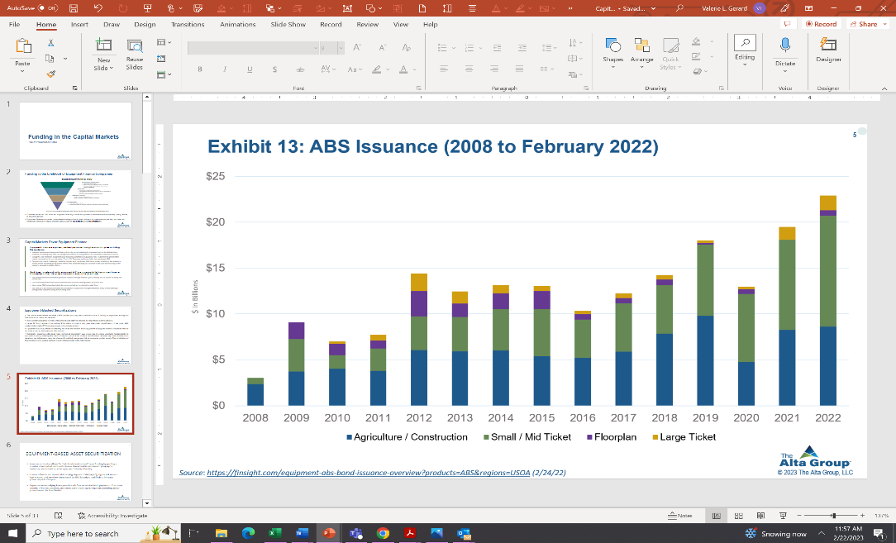
The $23 Billion Equipment ABS Market
Source: Finsight.
Notes:
The equipment ABS market is a large, active funding source for equipment finance companies.
Some of the most active issuers are large captive finance companies whose parent companies are recognizable names.
Equipment types commonly securitized include computers and peripherals, tractors, trucks, construction equipment.

Slide 6
Capital Markets Favor Equipment ABS
The $22.6 billion equipment ABS market is an attractive funding source for equipment finance firms given its demonstrated track record and strong investor demand.
The equipment ABS market has been a reliable source of funding for equipment finance firms for decades.
It is a critical funding tool for many independents as well as captives, such as John Deere and HP, because it is dependable and inexpensive.
Larger EF firms capable of securitizing $100 million or more at any given time prefer the efficiency of the public ABS market while smaller EF firms have access to the private market.
Equipment ABS truly affords accessibility for small and medium ticket equipment leasing and finance companies that do not have access to the unsecured debt markets.
Top Equipment ABS Issuers in 2022
Issuer | Total Issuance (MMs) | Number of Deals
Deere & Co. | $3,716 | 3
CNH Industrial NV | $2,513 | 3
Hewlett Packard | $2,398 | 3
Dell Technologies | $2,231 | 2
Mass Mutual Life Ins. | $1,798 | 2
Kubota Corp. | $1,617 | 2
Stonebriar Commercial Finance | $1,335 | 2
Amur Finance | $944 | 1
Rabo Bank (DLL) | $837 | 1
Daimler Truck AG | $800 | 1
Source: Finsight.
Notes:
Equipment ABS is a proven, resilient performer through economic cycles including the pandemic.
Historically, equipment ABS deals have performed consistently over cycle due to strong underlying fundamentals as supported by strong credit quality metrics which investors view as a strong risk-reward play.
Investors are attracted to equipment ABS because they have relatively short durations, low delinquency rates, low charge-offs and lack of prepayment risk as compared to other assets.
Despite the economic challenges created by the pandemic, equipment ABS demonstrated a resiliency that ensured a reliable source of funding for equipment finance firms while attracting new investors to the asset class seeking a safe means to generate favorable returns.

Slide 7
Syndication Is Another Important Capital Market Funding Tool
It is generally a secondary market transaction after the initial funding has occurred.
It mostly occurs when the requested loan amount is too large for a single lender, when the loan is outside the scope of a lender's risk exposure levels or when the lender wants to generate fee income by accelerating the profit in the transaction.
Multiple lenders pool together and form a syndicate to provide the borrower with the requested capital.
Syndication is used by most equipment finance companies to broaden the window of eligible transactions that it can fund on behalf of its customers.
Larger equipment finance companies have a buy and sell desk. Large equipment leases or loans may require a syndication strategy to meet the customer’s needs and bank’s credit requirements.

Slide 8



Example of Syndication:
ABC Bank Lessor originated an $80 million lease for 1,800 railcars. The credit committee approves a “hold position” of $50 million for this customer which means that it will syndicate the remaining $30 million to third party investors.
Benefits to the CUSTOMER
    Work with a single equipment finance and leasing firm to fund the railcars.
    Negotiate one set of documents.
    Deal with one servicer.
    Manage the credit exposure within hold limits.
    Earn fee income.
    Retain client relationship.
BENEFITS TO ABC BANK LESSOR, THE SYNDICATOR
ALLOCATION TO THIRD PARTY INVESTOR(S)
    Investor is allocated specific assets tied to the same lease.
    When the financing is for one large piece of equipment that can’t be divided such as a jumbo jet, the allocation is made by a Participation Agreement.

Slide 9
Portfolio Sales
A leasing company may have desire to decrease (or exit completely) their exposure to certain credits, industries, asset types, or geographies. Portfolio sale can efficiently accomplish this goal.
Leasing companies can use portfolio sales (in bulk or one-off) to manage the earnings stream or risk characteristics of their portfolio.
If equipment value increases during term, a new lessor may be able to assume a higher residual and a sale of the lease results in an immediate gain.
Example:
You booked a deal years ago for a weak credit at a high yield. Later, if the client’s credit has improved the deal can be sold for a large gain.

Slide 10
QUESTIONS?

