Slide 1
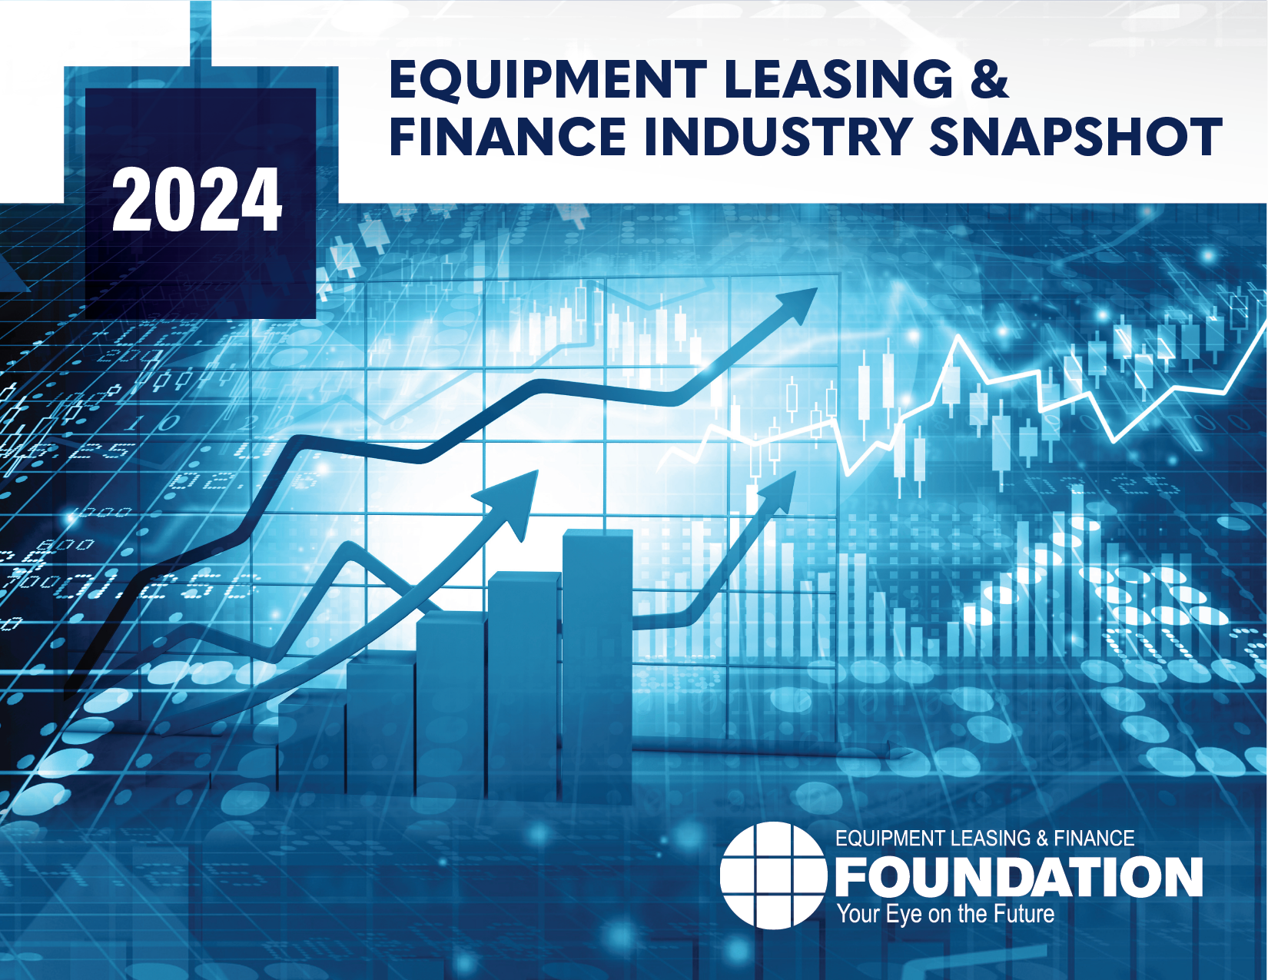


Snapshot of the Equipment Leasing and Finance Industry and U.S. Economy
April 2024
Prepared For:
Equipment Leasing & Finance Foundation
Prepared By:
Keybridge LLC

Slide 2
Data: Table of Contents
1. Overall Economy
p. 3
2. Investment
p. 9
3. Business Health
p. 12

Slide 3

Boosted by consumer spending, the economy expanded in Q4 2023 at a strong rate of 3.4% (SAAR).
Economy
Real GDP Growth
Annualized % Change from Prior Quarter
Forecast
30-Year Quarterly Average = 2.6%
3.4%
35.3%
-29.9%
Source: U.S. Bureau of Economic Analysis, Keybridge LLC
Notes:
The U.S. economy had another strong quarter of growth in Q4, with consumer and government spending boosting growth and investment while the labor market remained strong.
Consumer spending was the largest driver of economic growth in Q4. Looking ahead, the recent uptick in inflation and slowdown in real disposable income growth may translate into weaker real consumer spending later this year, particularly given rising debt levels.
Our view is that both job growth and consumer spending will slow in 2024 but remain healthy while inflation will inch toward the Fed’s 2% target over the course of the year.

Slide 4
Q4 growth was primarily driven by consumer and government spending, and supported by a boost in business investment and net exports.
Economy
Tailwinds & Headwinds
Contributions to GDP growth by sector
Residential Investment
(+0.11)
TAILWINDS
HEADWINDS
[+3.85]
[-0.47]
Change in Private Inventories
(-0.47)
Net Exports
+0.25
+0.50
Business Investment
+0.79
Government Spending
NET CHANGE
IN GDP
+3.4
Consumer Spending
+2.20
Source: U.S. Bureau of Economic Analysis, Keybridge LLC
Notes:
Economists often use a simple formula to describe the U.S. economy: “C + I + G + NX” (consumption + investment + government spending + net exports). With this in mind, the primary drivers of Q4’s expansion were consumer spending, government spending, business investment, net exports, and residential investment. Private inventories contributed negatively to GDP growth.
Consumer spending expanded 3.3% (annualized) in Q4 after similar 3.1% growth in Q3. Growth was similar for durable goods (3.2% annualized) and nondurable goods (2.9% annualized), while services (3.4% annualized) had its best growth since mid-2021.
Government spending grew solidly in Q4 (4.6% annualized). Spending was driven by a 6.0% annualized increase in state and local government spending and a 4.8% annualized increase in nondefense spending.
Exports grew 5.1% annualized in Q4, led by goods. Imports expanded 2.2% annualized, driven by services.
Equipment investment fell 1.1% annualized, the fourth contraction in the last five quarters (and second in a row). Transportation equipment was notably weak, while information processing equipment was positive for the first time since mid-2022. Software investment, by contract, expanded 4.3% annualized.

Slide 5


Economic Headwinds
HEADWINDS
Strong demand for new vehicles during the pandemic led to a 25% increase in auto prices over the last four years.
However, the combination of higher prices, higher interest rates, and higher insurance premiums have resulted in a more cautious consumer.
Reduced demand has already decreased prices and will likely continue to exert downward pressure in the near term.
Falling demand for new vehicles is another sign that consumer spending appears likely to slow this year.
Softening New Vehicle Sales
Sluggish Global Economic Growth
The global economy is positioned for weaker growth this year, reducing demand for US exports.
In the Eurozone, growth was negative in Q3 and flat in Q4. Germany, the region’s largest economy, contracted in 2023.
Meanwhile, China struggles with a real-estate crisis and weak consumption as household savings hit record highs.
Geopolitical conflict also remains a risk, which has significant implications for energy markets and global supply chains.
Source: 2024 Q2 Equipment Leasing & Finance U.S. Economic Outlook
Notes:
Headwinds
Vehicle Sales
The auto industry has been subject to turbulence over the last four years. As of January, the average price for a new vehicle is still 25% above pre-pandemic levels. Until recently, sales have held up relatively strong in spite of high prices.
Consumers are proving to be more cautious thus far this year. Vehicle inventories were elevated in February, and, while higher production levels are partially responsible for the backlog, demand is likely slowing.
With the average monthly payment for a new vehicle approaching $800 and auto insurance premiums 21% above year-ago levels, many consumers are likely delaying a new vehicle purchase until prices and interest rates are more affordable.
On the bright side, reduced demand may lead to lower prices. This should put downward pressure on inflation, as automobile prices were a significant contributor to the inflation spike in 2021 and 2022.
Still, falling demand for new vehicles is another sign that consumer spending appears likely to slow this year.
Weak Global Economy
The IMF’s global growth forecast for 2024 is 3.1%, which is slightly slower than 2023 and well below the historical average. Challenges are particularly acute in the Eurozone and China:
Eurozone growth was negative in Q3 and flat in Q4. The region’s largest economy (Germany) contracted last year and is expected to expand just 0.2% this year, making it the world’s worst performing major economy. Labor productivity has fallen consistently across the region even as wages rise, complicating efforts to tame inflation.
In China, growth was officially clocked at 5.2% in 2023 (though some independent estimates question this figure), and economists predict a further slowing to 4.6% in 2024 due to the ongoing property crisis and weakening consumption as the population ages.
Geopolitical conflict remains a risk. The Russia-Ukraine and Israel-Palestine wars continue, and the prospect of a broader regional conflict in the Middle East or an escalation of tensions between China and surrounding areas could have significant implications for energy markets and global supply chains.

Slide 6


Economic Tailwinds
TAILWINDS
Though a significant driver of inflation in 2021 and 2022, energy prices have put downward pressure on inflation over the last year due to record-high U.S. production levels for both oil and natural gas.
Natural gas averaged a record low price in February after adjusting for inflation, driving down utility bills.
Though oil prices have been more turbulent, prices may soon start on a path of gradual decline given softening global demand projections.
Easing Energy Prices
Job Growth
The labor market remains the U.S. economy’s strongest tailwind. Robust job growth continued in Q1, while wage growth outpaced inflation.
At the same time, the labor market appears to be at lower risk of overheating, which is a positive sign for containing inflation.
Job openings, while still elevated, have come down significantly since peaking in early 2022. Further, the quit rate has eased and hiring in the leisure and hospitality sector has normalized.
Source: 2024 Q2 Equipment Leasing & Finance U.S. Economic Outlook
Notes:
Tailwinds:
Energy Prices
In 2021 and 2022, high energy prices were a significant driver of inflation.
However, over the last year, energy prices have put downward pressure on inflation due to a combination of:
record-high U.S. production levels for both oil and natural gas
and global anxiety over a potential China economic slowdown.
Natural gas averaged a record low price in February after adjusting for inflation. As a result, consumers’ utility bills were down 9% Y/Y in February and 3.2% Y/Y in March.
Crude oil prices dipped below $70 per barrel in late 2023, giving consumers a significant reprieve, and while they have since rebounded to around $90 per barrel in early April, prices may soon fall given softening global demand projections. Lower oil prices allow U.S. consumers to redirect spending to other areas of the economy, helping to drive growth.
Job Growth
The labor market remains the U.S. economy’s strongest tailwind, with robust job growth continuing in Q1 and wage growth continuing to outpace inflation.
At the same time, the labor market appears to be at lower risk of overheating, which is a positive sign for containing inflation. For example, in addition to slower wage growth:
Job openings, while still elevated, have come down significantly since peaking in early 2022.
The quit rate fell to its lowest reading since 2020, indicating that employees are less inclined to seek greener pastures (and higher wages).
The leisure and hospitality sector has normalized after a period of rapid growth.
Looking ahead, we expect the labor market to cool gradually but remain healthy over the course of the year. On balance, slower job growth would be preferable for the economy than the 275K/month average experienced thus far in 2024 to reduce the risk of a resurgence of inflation.

Slide 7

Factors to Watch
FACTOR TO WATCH
Consumer Spending Slowdown?
Consumer demand has been robust over the last four years, driving the U.S. economic recovery.
But, with consumer debt levels (particularly credit card and auto loan debt) above pre-recession levels and rising quickly, can consumers maintain current spending levels?
Spending growth is catching up with income growth, driving the personal savings rate downward. Meanwhile, revolving debt is rising quickly, and student loan payments have now resumed.
Delinquency rates for both credit cards and auto loans are up and 36% of households report difficulty paying usual expenses.
A spending slowdown appears to be inevitable, but strong job and wage growth may result in a more gradual decline.
Source: 2024 Q2 Equipment Leasing & Finance U.S. Economic Outlook
Notes:
Factor to Watch
Consumer Spending Slowdown?
Consumer demand has powered U.S. the economic recovery forward since 2020.
But, with consumer debt levels (particularly credit card and auto loan debt) above pre-recession levels and rising quickly, can consumers maintain current spending levels?
Warning signs:
Spending Growth vs. Income Growth: Real personal consumption expenditures have outpaced real disposable income growth for six out of the last nine months. While real disposable income is still greater than expenditures, the gap between the two is shrinking, resulting in the personal savings rate falling to 3.6% as of February, roughly half the long-term average of 7%.
Revolving Debt: Credit card balances rose $50 billion in Q4 2023 and ended the year at $1.13 trillion. While higher interest rates make credit card borrowing more expensive, this hasn’t slowed down consumers: outstanding revolving credit expanded 8.8% in 2023 and has risen at a similar rate thus far in 2024.
Student Loans: Roughly 40% of borrowers missed their first payment last fall, and while this figure is likely lower today, it suggests that the repayment “on-ramp” may be delaying the full impact of repayment on other forms of spending.
Financial Stress: Delinquency rates continue to rise for both credit card and auto loans, and both rates are now above pre-pandemic levels.
Looking ahead, an eventual slowdown in spending appears inevitable given historical trends. At the same time, strong job and wage growth in Q1 may well result in a gradual decline.

Slide 8
Projections for Key Economic Indicators
Indicator | 2022 | 2023e | 2024 Quarterly Estimates |  |  |  | 2024e
 |  |  | Q1e | Q2e | Q3e | Q4e
Real GDP (SAAR %) | 1.9% | 2.5% | 1.7% | 1.0% | 1.5% | 1.8% | 2.3%
Real Investment in Equipment & Software (SAAR %) | 7.9% | 3.0% | 0.7% | 2.1% | 2.9% | 3.7% | 2.2%
Inflation (year-on-year %) | 8.0% | 4.1% | 3.5% | 3.2% | 2.8% | 2.7% | 2.7% (end of year)
Federal Funds Target Rate (upper bound, end of period) | 4.50% | 5.50% | 5.50% | 5.50% | 5.25% | 5.00% | 5.0% (end of year)
Total Payroll Growth (thousands) | 4,793 | 3,013 | 829 | 600 | 525 | 450 | 2,404
Source: 2024 Q2 Equipment Leasing & Finance U.S. Economic Outlook
Notes:
GDP: We expect real GDP to grow by 2.3% in 2024, a relatively healthy year of economic growth.
Investment: We expect E&S investment to be weaker in 2024 than 2023, as elevated interest rates grate on investment activity.
Inflation: We expect inflation to continue to decline over the course of 2024, with CPI inflation falling below 3% in the second half of the year.
Interest Rates: We expect the Federal Reserve to respond to delay rate cuts while economic growth remains strong until the second half of the year. We expect the Fed to respond to easing inflation with two rate cuts during 2024.
Job Growth: The labor market continues to impress, maintaining its strength through Q4. We expect job growth to perform well in 2024, adding 2.4 million jobs.

Slide 9
Business investment expanded at a 3.7% annualized pace in Q4, driven by growth in non-residential structures investment.
Investment
Business Investment
Real Nonresidential Fixed Investment, % Change from Prior Quarter
3.7%
-29.4%
Source: U.S. Bureau of Economic Analysis
Notes:
Business investment grew in Q4, rising 3.7% (annualized). Growth accelerated from a weak 1.4% in the previous quarter.
Business investment (also known as nonresidential fixed investment) consists of three elements: equipment, software and R&D, and non-residential structures (e.g., commercial buildings, oil platforms).
Equipment: -1.1% (annualized) (up from -4.4% in Q3)
Non-residential structures: +10.9% (annualized) (down from +11.2% in Q3)
Software and R&D: +4.3% (annualized) (up from +1.8% in Q3)

Slide 10
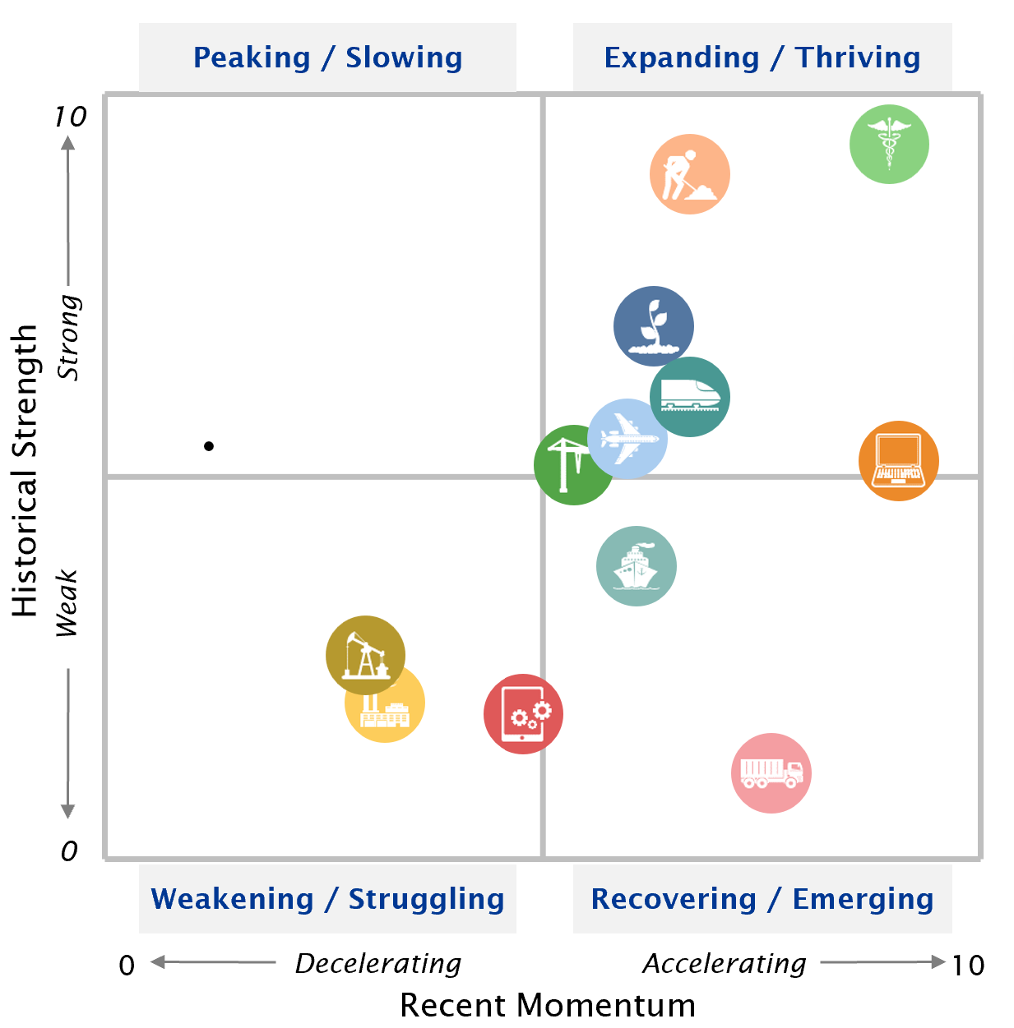
Five of 12 verticals have readings significantly above their historical average, while several are at or below their historical average.
Investment
Equipment & Software Investment Momentum Monitor
Equipment Vertical Performance Matrix
Source: 2024 Equipment Leasing & Finance U.S. Economic Outlook
For more information on how to use the Momentum Monitors, see final slide.
Notes:
Equipment and Software investment expanded 3.2% in Q4 (annualized) a slight contraction (-0.3%) in Q3.
Based on the latest data, investment growth in the following equipment verticals appears set to expand in the coming ~6 months:
Computers
Medical
Based on the latest data, investment growth in the following equipment verticals appears set to shrink in the coming ~6 months:
Other Industrial
Mining & Oilfield
Notes about the Equipment Vertical Performance Matrix: The matrix above summarizes the current values of each of the 12 Equipment & Software Investment Momentum Indices based on two factors: Recent Momentum (x-axis) and Historical Strength (y-axis). The matrix is comprised of four quadrants according to each vertical’s “recent momentum” and “historical strength” readings (see last slide in deck for a description of these terms):
If a vertical is located in the top-left quadrant, its momentum reading is higher than average, but positive movement has slowed (and perhaps reversed) in recent months — suggesting that investment growth may worsen over the next 2 quarters.
Verticals located in the bottom-right quadrant, however, have momentum readings that are below average, but recent movement shows promise — suggesting that investment levels may rise over the next 2 quarters. This makes them potentially attractive targets for new leasing and finance opportunities.

Slide 11
E&S investment growth is forecasted to strengthen somewhat over the course of the year, but the annual forecast of 2.2% is modest.
Investment
Real Equipment & Software Investment Growth
Q/Q % change, SAAR
Forecast
40.1%
3.2%
-14.0%
-28.3%
Source: U.S. Bureau of Economic Analysis; Projections from Keybridge
Notes:
E&S investment accelerated in Q4, rising 3.2% (annualized) after shrinking 0.3% in Q3. Elevated interest rates will continue to drag on investment in 2024, and the climate for near-term investment is still relatively weak.
The Foundation expects real equipment and software investment to grow at a 2.2% annualized pace in 2024.

Slide 12

New business volume was up 4.9% year-to-date in February, currently outpacing of the rate of inflation.
Bus. Health
MLFI-25 New Business Volume (NBV)
Billions of $
Source: ELFA MLFI-25
*Note: The MLFI-25 reports economic activity from 25 companies representing a cross section of the equipment finance sector. It does not represent the total size of the equipment finance industry.
Notes:
According to ELFA’s Monthly Leasing and Finance Index, new business volume was up 4.9% year-to-date (nominal) in February. In 2023, new business volume grew 3.2%, roughly in line with inflation.
*Note: ELFA's Monthly Leasing and Finance Index (MLFI-25) reports economic activity from 25 companies representing a cross section of the equipment finance sector. 2023 value is projected cumulative annual volume assuming May’s YTD growth rate.

Slide 13
On a nominal basis, year-over-year growth in new business volume was positive in January and February.
Bus. Health
MLFI-25 New Business Volume (NBV)
Y/Y % change
New business volume is up 4.9% year-to-date
3.9%
Source: ELFA MLFI-25
*Note: The MLFI-25 reports economic activity from 25 companies representing a cross section of the equipment finance sector. It does not represent the total size of the equipment finance industry.
Notes:
According to ELFA’s Monthly Leasing and Finance Index, new business volume was up 3.9% year-over-year in February, laying the foundation for moderate, positive growth at the start of 2024.
Portfolio performance improved modestly in February:
Charge-offs fell 0.5% from the previous month to 0.4% (up 0.3% Y/Y)
30+ day receivable were 2.2%, down from 2.3% the previous month but up from 1.8% from a year prior.
Meanwhile, credit approvals were unchanged from January, up 1.8% year over year.
*Note: ELFA's Monthly Leasing and Finance Index (MLFI-25) reports economic activity from 25 companies representing a cross section of the equipment finance sector.

Slide 14
Equipment finance industry confidence improved over the first few months of 2024. It fell modestly in April but remains above 2023 readings.
Bus. Health
Monthly Confidence Index: Equipment Finance Industry (MCI-EFI)
52.9
Source: ELFF MCI-EFI
Notes:
Confidence among equipment industry executives fell 4.2% Y/Y in April after growing in Q1.
11% of respondents expect business conditions to improve in the next four months, while 86% expect conditions to remain the same.
Most respondents (93%) expect demand for leases and loans to fund capex to remain the same.
Roughly one fourth of respondents expect hire more employees, while 71% expect no change in hiring over the next four months.
While most respondents (93%) rate the economy as “fair,” 7.1% assess it as “poor,” up from 6.5% in March.
Note: The MCI-EFI is produced by the Foundation each month using a survey of key industry executives from banks, captives, and independent firms. It is designed to provide a qualitative assessment of both the prevailing business conditions and expectations for the future.

Slide 15
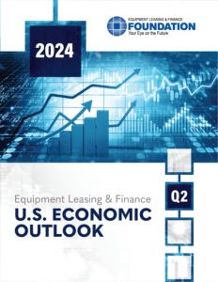
EQUIPMENT LEASING & FINANCE FOUNDATION
The latest edition of the Keybridge / Foundation U.S. Economic Outlook is available here at the Foundation’s website.
Reports are available to download at www.store.leasefoundation.org

Slide 16
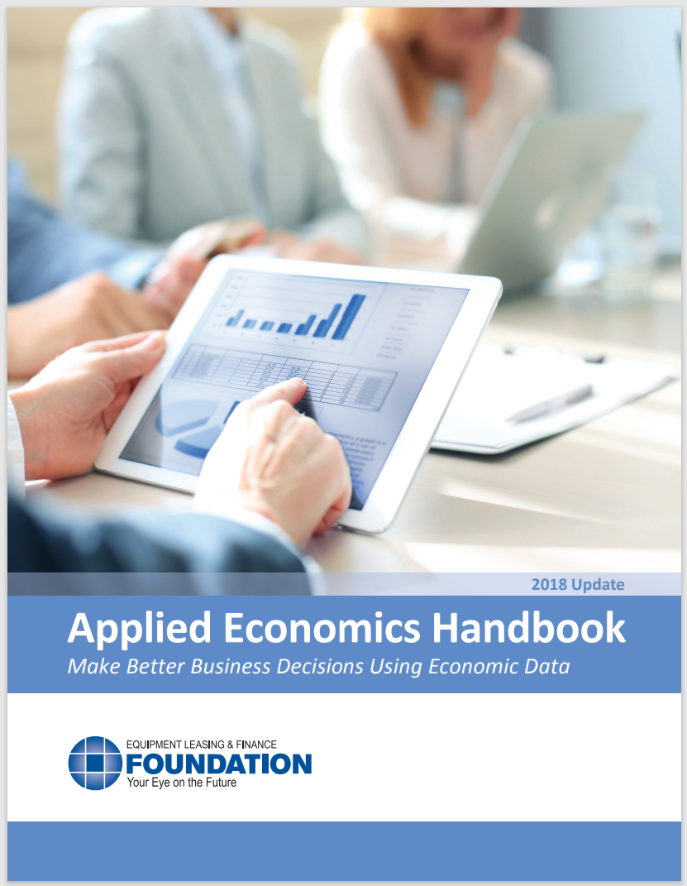
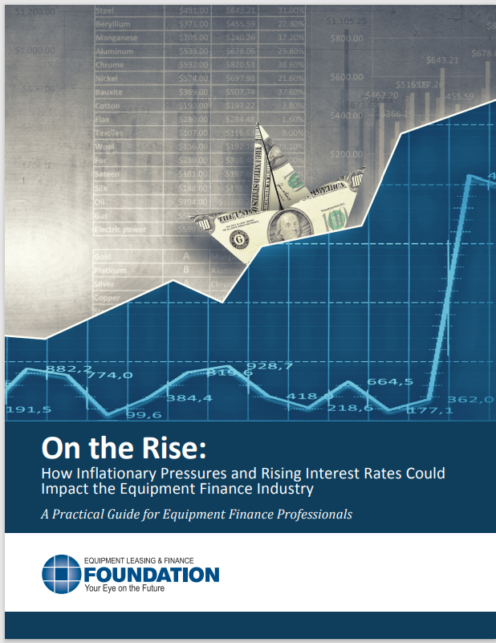
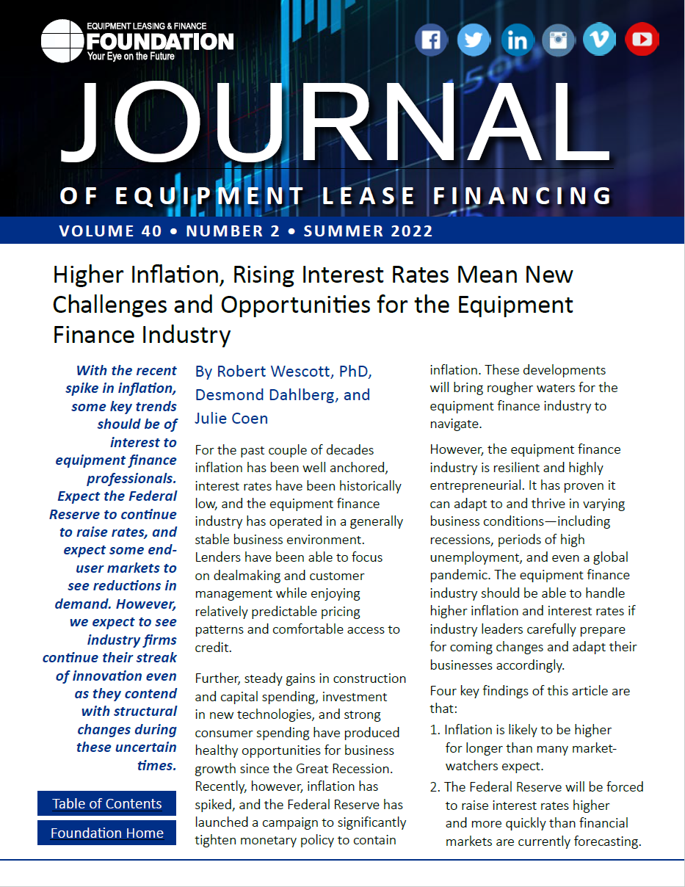
EQUIPMENT LEASING & FINANCE FOUNDATION
For more information, download the Applied Economics Handbook or research articles (2018 & 2022) analyzing the effect of inflation and rising interest rates on the equipment finance industry.

Slide 17
Notes
*U.S. Equipment & Software Investment Momentum Monitor (Slide 10)
Published monthly, the U.S. Equipment & Software Investment Momentum Monitor is a set of leading indicators for the equipment sector consisting of indices for various equipment and software investment verticals. These indices are designed to identify turning points in their respective investment cycles with a ~6-month lead time.
Each index is comprised of ~20 high-frequency indicators and is statistically optimized to signal turning points in the investment cycle without giving false readings of shifts in momentum.
The Momentum Monitor covers 12 equipment and software verticals as defined by the U.S. Department of Commerce Bureau of Economic Analysis. These verticals include aircraft, agriculture machinery, computers, construction machinery, materials handling equipment, medical equipment, mining and oilfield equipment, other industrial equipment, railroad equipment, ships and boats, software, and trucks.
“Recent Momentum" represents the degree of an indicator's recent acceleration or deceleration in the past month relative to its average movement during the previous 3 months. Ratings closer to "0" represent an indicator that is rapidly decelerating, while ratings closer to “10” represent an indicator that is rapidly accelerating.
"Historical Strength" represents the strength or weakness of an indicator in the past month relative to its typical level since 1999. Ratings closer to "0" represent an indicator that is weaker than average, while ratings closer to "10" represent an indicator that is stronger than average.

