Slide 1
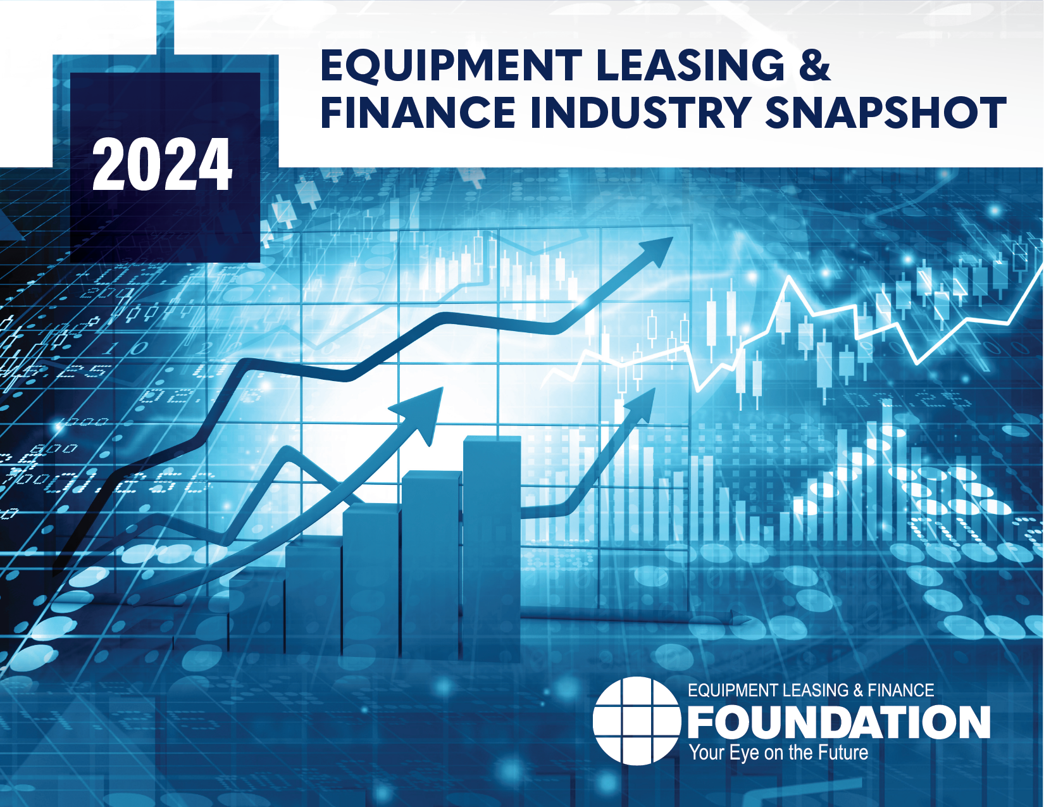


Snapshot of the Equipment Leasing and Finance Industry and U.S. Economy
December 2023
Prepared For:
Equipment Leasing & Finance Foundation
Prepared By:
Keybridge LLC

Slide 2
Data: Table of Contents
1. Overall Economy
p. 3
2. Investment
p. 9
3. Business Health
p. 13

Slide 3

The economy expanded in Q3 2023 at a rapid pace of 5.2% (SAAR), boosted by consumer and government spending.
Economy
Real GDP Growth
Annualized % Change from Prior Quarter
Forecast
+5.2%
30-Year Quarterly Average = 2.6%
35.3%
-29.9%
Source: U.S. Bureau of Economic Analysis, Keybridge LLC
Notes:
The U.S. economy had a remarkably strong Q3, with consumer and government spending boosting growth and investment while the labor market remained strong.
Just as importantly, robust economic growth was paired with a steady decline in inflation: headline CPI inflation was just 3.2% in October, while the Core PCE Price Index (the Fed’s preferred inflation measure) was 3.5%.
The unusual combination of 5+ percent growth, a healthy labor market, and cooling inflation has resulted in more optimism about the economy’s prospects.

Slide 4
The Q3 expansion was broad-based, fueled primarily by consumer spending, government spending, and private inventories.
Economy
Tailwinds & Headwinds
Contributions to GDP growth by sector
Business Investment
(+0.18)
TAILWINDS
HEADWINDS
[+5.20]
[-0.04]
Net Exports
(-0.04)
Residential Investment
(+0.24)
+0.55
Government Spending
+0.57
NET CHANGE
IN GDP
+5.16
Private Inventories
Consumer Spending
+0.98
Source: U.S. Bureau of Economic Analysis, Keybridge LLC
Notes:
Economists often use a simple formula to describe the U.S. economy: “C + I + G + NX” (consumption + investment + government spending + net exports). With this in mind, the primary drivers of Q3’s expansion were consumer spending, government spending, and private inventories. Net exports contributed slightly negatively to GDP growth, while Residential Investment and Business Investment were slightly positive.
Consumer spending expanded 3.6% (annualized) in Q3 after modest 0.8% growth in Q2. Durable goods fueled the increase (+6.8%) while non-durable goods (+3.5%) had its best quarter since mid-2021.
Government spending grew solidly in Q3, driven by a sharp 8.2% annualized increase in federal defense spending. Federal non-defense spending expanded 5.5% while state and local spending increased 4.6%.
Residential investment grew 6.2% annualized, the first expansion since early Q1 2021 and a sign that the housing market may have turned a corner.
Equipment investment fell 3.5% annualized as most subcategories contracted other than transportation, which was essentially unchanged. Software investment, however, expanded for the 14th consecutive quarter.
Net exports fell slightly, as increased imports more than offset an increase in exports.

Slide 5


Special Topics: Consumer Financial Stress & Labor Market
Consumer Financial Stress & Labor Market
Revolving credit is now at its highest point on record and is growing significantly faster than its pre-pandemic trend.
The rise in interest rates has made servicing this debt more expensive, leading to more U.S. consumers exhibiting signs of financial stress.
Financial stress will be a key factor to watch in 2024. The revolving debt accrued this spring and summer that helped drive robust economic growth will likely lead to higher delinquency rates in the months ahead.
Consumer Financial Stress
Labor Market
The labor market was a pillar of strength in the economy in 2023. However, small cracks are showing that will be key to watch in 2024:
Job Growth: While the healthcare and food services industry have been expanding, growth in most private industries has been modest.
Wage Growth: With inflation falling to more acceptable levels, real wage growth has improved, even as nominal wage growth has fallen.
Turnover: Quit rates and job openings per unemployed person are trending downwards, a sign that the labor market is loosening.
Source: 2023 Q2 Equipment Leasing & Finance U.S. Economic Outlook
Notes:
Consumer Financial Stress:
Debt levels and financial stress have been on the rise and are a key factor to watch in 2024.
Revolving credit is now at its highest point on record and is still growing significantly faster than its pre-pandemic trend. A similar trend is occurring for auto loans.
The rapid rise in interest rates since 2021 has made repaying this debt significantly more expensive.
Given the rapid increase in both consumer debt levels and the cost of servicing that debt, it should come as no surprise that U.S. consumers are exhibiting increasing signs of financial stress.
More financial stress is still to come, as the revolving debt that accrued this spring and summer and helped drive robust economic growth in Q3 will likely lead to higher delinquency rates in the months ahead.
Headwinds:
The labor market remained a pillar of strength in the U.S. economy in 2023. However, there are a several trends to watch in 2024:
Job Growth: Over the last six months healthcare, accommodation & food services, and government sectors were responsible for a large portion of payrolls growth. Several major private sector industries have either flatlined or contracted during the first two months of Q4, including Manufacturing (-7K), Professional & Business Services (-7K), Information Services (-9K), Transportation & Warehousing (-17K), and Retail Trade (-43K).
Wage Growth: Nominal wage growth has typically been 1-2 percentage points above the rate of inflation, but this relationship flipped in April 2021 as inflation accelerated. For two years, inflation exceeded wage growth, leaving consumers worse off overall. Now, real wage growth has once again turned positive, even as
nominal wage growth slowly recedes. A key question in 2024 is whether wages continue to grow above the inflation rate, or whether a slowdown in consumer spending leads to a positive feedback loop of reduced demand for workers and slower wage growth, which would likely trigger a recession.
Job Openings and Quit Rates: In recent months, job openings per unemployed worker have fallen while the quit rate has returned to its pre-pandemic level. These trends suggest that the tight labor market is loosening.

Slide 6


Special Topic: The Global Economy
GLOBAL ECONOMY
Global Conflict Impacts Energy Prices and U.S. Businesses
The economic impact of mounting geopolitical tensions is a key area of uncertainty facing the U.S. economy in 2024.
The Russia-Ukraine war is likely to continue to impact stability in Europe and threatens to disrupt supply chains.
Political tensions between the U.S. and China continue to complicate business for multinational companies.
Conflict in the Middle East could broaden outside Israel’s borders and further destabilize the region, potentially impacting major oil exporters
Weak Global Demand
While U.S. economic growth exceeded expectations this year, many other economies struggled.
Inflation was pervasive in Europe, leading to contraction in several manufacturing-oriented economies, including Germany.
China’s real estate sector is still in crisis, weakening consumer confidence, reducing manufacturing activity, and weakening demand.
The IMF is forecasting global growth of 2.9% in 2024, slightly slower than 2023 and well below the historical average.
Source: 2024 Equipment Leasing & Finance U.S. Economic Outlook
Notes:
Global Economy
Global Conflict:
The economic impact of mounting geopolitical tensions is a key area of uncertainty facing the U.S. economy this year.
The Russo-Ukrainian war is likely to continue to impact stability in Europe and threatens to disrupt supply chains.
Political tensions with China continue to complicate business for multinational companies, accelerating efforts to diversify supply chains.
From an economic perspective, war in Israel-Palestine could potentially impact major oil exporters and destabilize energy markets in the region.
Global Demand:
While U.S. economic growth exceeded expectations this year, many other economies struggled.
Inflation was pervasive in Europe, leading to contraction in several manufacturing-oriented economies, including Germany.
Growth was weak across the EU (+0.6% Y/Y). However, the IMF is now expressing cautious optimism that most European Union countries will avoid an outright recession, even as overall growth remains weak.
One of the biggest downside risks to the global economy is an economic slowdown in China. After decades of overbuilding that was fueled by excess borrowing, China’s real estate sector is in crisis.
Overall, the IMF is forecasting 2.9% growth in 2024, slightly slower than 2023 and well below the historical average. However, while global growth rates may disappoint in 2024, this could allow the Fed to lower interest rates with more confidence that doing so will not reignite inflation.

Slide 7


Special Topic: Housing & Manufacturing Industries in Focus
INDUSTRIES IN FOCUS
High interest rates dealt a significant blow to the housing market in 2023. Housing affordability is at its lowest point in 40 years.
Many homeowners purchased or refinanced their homes within the last three years at historically low interest rates. This created a “lock-in” effect that has severely curtailed the number of homes on the market.
In response, more would-be homebuyers are constructing new homes instead of purchasing existing ones, giving a boost to construction equipment investment.
Housing
Manufacturing
Headwinds were strong in the manufacturing sector this year, and by some measures the sector has been mired in a mini-recession.
Aside from high interest rates, U.S. manufacturers must also contend with soft global demand, worker shortages, and high labor costs.
Still, some manufacturing industries are benefitting from an influx of federal dollars, driving demand for construction machinery; mining, oil & gas equipment; batteries & electrical equipment; power transmission equipment; and semiconductors.
Source: 2024 Equipment Leasing & Finance U.S. Economic Outlook
Notes:
Industries in Focus:
Housing
High interest rates dealt a significant blow to the housing market in 2023. Housing affordability is at its lowest point in 40 years.
An increasing share of prospective homebuyers have sought newly constructed homes instead of previously owned homes. As a result, housing construction has not fallen as much as it would have otherwise.
Manufacturing
Headwinds were strong in the manufacturing sector this year, and by some measures the sector has been mired in a mini-recession:
The ISM Manufacturing Purchasing Managers Index (PMI) was 46.7 in November, its 13th consecutive month below 50.
Overall industrial production fell 0.7% Y/Y in October and has been essentially flat all year. Industrial production for manufacturing is down 1.7% Y/Y.
Capacity utilization for manufacturing has trended downward for the last six months and fell 0.6 pp to 77.2% in October. It is now below its average reading for the five-year period preceding the pandemic.
Aside from high interest rates, U.S. manufacturers must also content with other headwinds. For example, soft global demand is likely to dampen the prospects for U.S. exporters, while worker shortages and high labor costs are an ongoing challenge.
Still, some manufacturing industries are booming. The hundreds of billions of federal dollars authorized by major legislation passed in 2022 should boost demand in several industries this year, likely benefitting equipment verticals such as construction machinery; mining, oil & gas equipment, batteries & electrical equipment, and power transmission equipment.
Moreover, demand is expected to remain strong for semiconductors and green energy, and if interest rates begin to fall in 2024 as expected, business that paused capital expenditure plans in 2023 due to the high cost of borrowing may revisit these investments, particularly during the second half of the year.

Slide 8
Projections for Key Economic Indicators
Indicator | 2022 | 2023e | 2024 Quarterly Estimates |  |  |  | 2024e
 |  |  | Q1e | Q2e | Q3e | Q4e
Real GDP (SAAR %) | 1.9% | 2.4% | 0.5% | 1.5% | 1.8% | 2.0% | 1.7%
Real Investment in Equipment & Software (SAAR %) | 7.9% | 3.0% | 0.7% | 2.7% | 3.5% | 4.5% | 2.2%
Inflation (year-on-year %) | 8.0% | 4.1% | 2.9% | 2.9% | 2.7% | 2.6% | 2.8%
Federal Funds Target Rate (upper bound, end of period) | 4.50% | 5.50% | 5.25% | 5.00% | 4.75% | 4.75% | 4.75%
Total Payroll Growth (thousands) | 4,793 | 2,663 | 350 | 250 | 280 | 320 | 1,200
Source: 2024 Annual Equipment Leasing & Finance U.S. Economic Outlook
Source: 2024 Equipment Leasing & Finance U.S. Economic Outlook
Notes:
GDP: We expect real GDP to grow by 1.7% in 2024, with weak but positive growth in Q1.
Investment: We expect E&S investment to be weaker in 2024 than 2023, as elevated interest rates grate on investment activity.
Inflation: We expect inflation to continue to decline over the course of 2024, with CPI inflation falling below 3% as early as Q1.
Interest Rates: We expect the Federal Reserve to respond to weak but positive growth in Q4 and easing inflation by beginning rate cuts as early as Q1. We are projecting three rate cuts during 2024.
Job Growth: The labor market continues to impress, maintaining its strength through Q3. We expect job growth to perform reasonably well in 2024, adding 1.2 million jobs.

Slide 9
Business investment expanded at a 1.3% annualized pace in Q3, driven by growth in non-residential structures investment.
Investment
Business Investment
Real Nonresidential Fixed Investment, % Change from Prior Quarter
1.3%
-29.4%
Source: U.S. Bureau of Economic Analysis
Notes:
Business investment grew in Q3, rising 1.3% (annualized), Growth decelerated from a sharp 7.4% in the previous quarter.
Business investment (also known as nonresidential fixed investment) consists of three elements: equipment, software and R&D, and non-residential structures (e.g., commercial buildings, oil platforms).
Equipment: -3.5% (annualized) (down from 7.7% in Q2)
Non-residential structures: +6.9% (annualized) (down from +16.1% in Q2)
Software and R&D: +2.8% (annualized) (down from +2.7% in Q1)

Slide 10
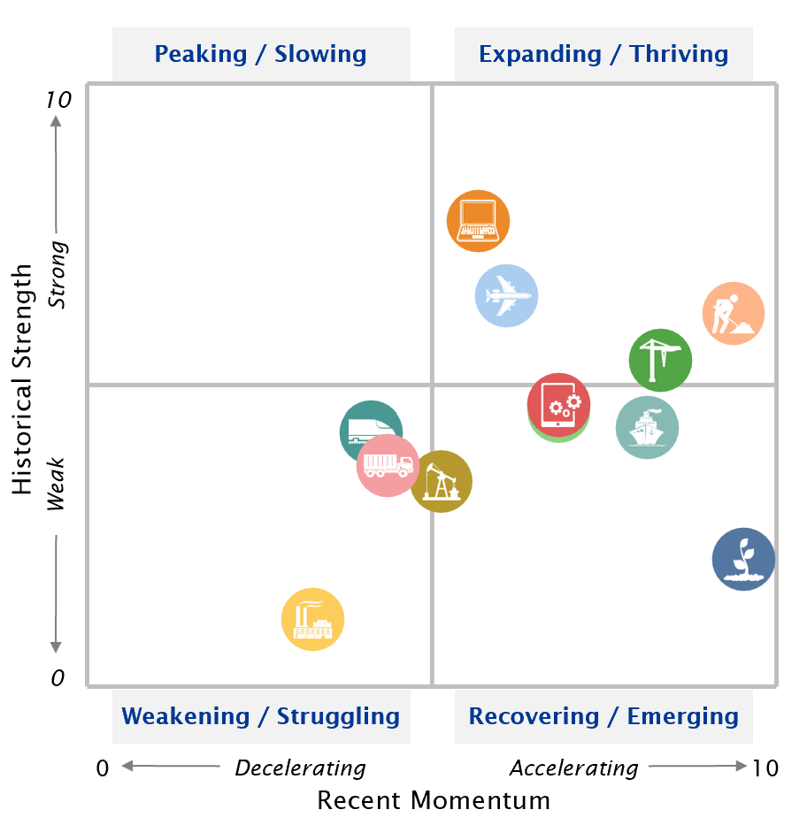
Eight of 12 verticals are below their historical average, though several have improved recently.
Investment
Equipment & Software Investment Momentum Monitor
Equipment Vertical Performance Matrix
Source: 2024 Equipment Leasing & Finance U.S. Economic Outlook
For more information on how to use the Momentum Monitors, see final slide.
Notes:
Equipment and Software investment expanded a sluggish 0.5% in Q3 (annualized) after growing 7.0% the previous quarter.
Based on the latest data, investment growth in the following equipment verticals appears set to expand in the coming ~6 months:
Computers
Aircraft
Software
Construction
Notes about the Equipment Vertical Performance Matrix: The matrix above summarizes the current values of each of the 12 Equipment & Software Investment Momentum Indices based on two factors: Recent Momentum (x-axis) and Historical Strength (y-axis). The matrix is comprised of four quadrants according to each vertical’s “recent momentum” and “historical strength” readings (see last slide in deck for a description of these terms):
If a vertical is located in the top-left quadrant, its momentum reading is higher than average, but positive movement has slowed (and perhaps reversed) in recent months — suggesting that investment growth may worsen over the next 2 quarters.
Verticals located in the bottom-right quadrant, however, have momentum readings that are below average, but recent movement shows promise — suggesting that investment levels may rise over the next 2 quarters. This makes them potentially attractive targets for new leasing and finance opportunities.

Slide 11
E&S investment growth is forecasted to remain positive but weak in 2024 as elevated interest rates continue to cool businesses investment.
Investment
Real Equipment & Software Investment Growth
Q/Q % change, SAAR
Forecast
40.1%
0.5%
-14.0%
-28.3%
Source: U.S. Bureau of Economic Analysis; Projections from Keybridge
Notes:
E&S investment was sluggish in Q3, rising 0.5% (annualized) after 7.0% growth in Q2. Elevated interest rates will continue to drag on investment in 2024, and the climate for near-term investment is still relatively weak.
The Foundation expects real equipment and software investment to grow at a 2.2% annualized pace in 2024.

Slide 12

New business volume was up 0.7% year-to-date in October, currently trailing the rate of inflation.
Bus. Health
MLFI-25 New Business Volume (NBV)
Billions of $
Source: ELFA MLFI-25
*Note: The MLFI-25 reports economic activity from 25 companies representing a cross section of the equipment finance sector. It does not represent the total size of the equipment finance industry.
Notes:
According to ELFA’s Monthly Leasing and Finance Index, new business volume was up 0.7% year-to-date (nominal) in October. After strong growth in early 2023, year-to-date new business volume growth softened in Q2 and Q3 in the face of interest rates and tightening lending standards.
*Note: ELFA's Monthly Leasing and Finance Index (MLFI-25) reports economic activity from 25 companies representing a cross section of the equipment finance sector. 2023 value is projected cumulative annual volume assuming May’s YTD growth rate.

Slide 13
On a nominal basis, year-over-year growth in new business volume was negative in September and October.
Bus. Health
MLFI-25 New Business Volume (NBV)
Y/Y % change
New business volume is up 0.7% year-to-date
-8.0%
Source: ELFA MLFI-25
*Note: The MLFI-25 reports economic activity from 25 companies representing a cross section of the equipment finance sector. It does not represent the total size of the equipment finance industry.
Notes:
According to ELFA’s Monthly Leasing and Finance Index, new business volume was down 8.0% year-over-year in October. New business volume has slowed in recent months in the face of elevated interest rates.
High interest rates have impacted portfolio performance, which has weakened somewhat. In October,
Charge-offs rose 6bps to 0.42% (up 16bps Y/Y)
30+ day receivables remaining at a three-year high of 2.5% (up 80 bps Y/Y)
Despite slipping portfolio performance, credit approvals improved, rising from 73.6% to 76.0%.
*Note: ELFA's Monthly Leasing and Finance Index (MLFI-25) reports economic activity from 25 companies representing a cross section of the equipment finance sector.

Slide 14
Equipment finance industry confidence is now near a post-pandemic low.
Bus. Health
Monthly Confidence Index: Equipment Finance Industry (MCI-EFI)
42.8
Source: ELFF MCI-EFI
Notes:
Confidence among equipment industry executives fell roughly 2.1% Y/Y in November, back to post-recession lows.
No respondents expect business conditions to improve in the next four months. Three-fourths of respondents expect conditions to remain the same.
No respondents expect demand for leases and loans to fund capex to increase. Three-fourths of respondents expect steady demand, while one-fourth expect demand to worsen.
While most respondents expect do not anticipate a change in their hiring plans, the share who expect hiring to improve (15%) is roughly double the share who expect it to decline (7%).
While most respondents (82%) rate the economy as “fair,” 15% assess it as “poor,” up from 7% in October.
Note: The MCI-EFI is produced by the Foundation each month using a survey of key industry executives from banks, captives, and independent firms. It is designed to provide a qualitative assessment of both the prevailing business conditions and expectations for the future.

Slide 15
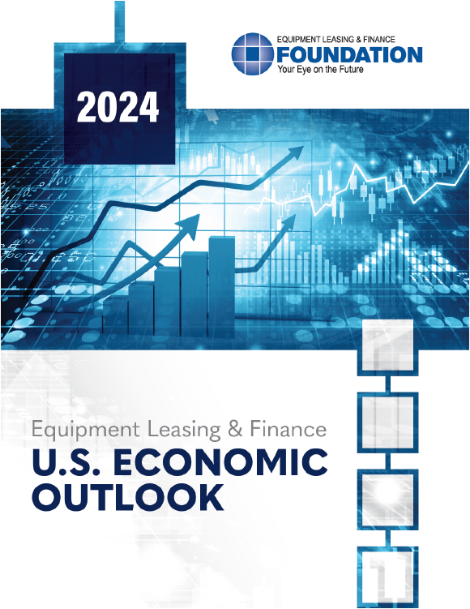
EQUIPMENT LEASING & FINANCE FOUNDATION
The latest edition of the Keybridge / Foundation U.S. Economic Outlook is available here at the Foundation’s website.
Reports are available to download at www.store.leasefoundation.org
Notes:
Note: the updated Applied Econ Handbook is available for free on the Foundation’s website.

Slide 16
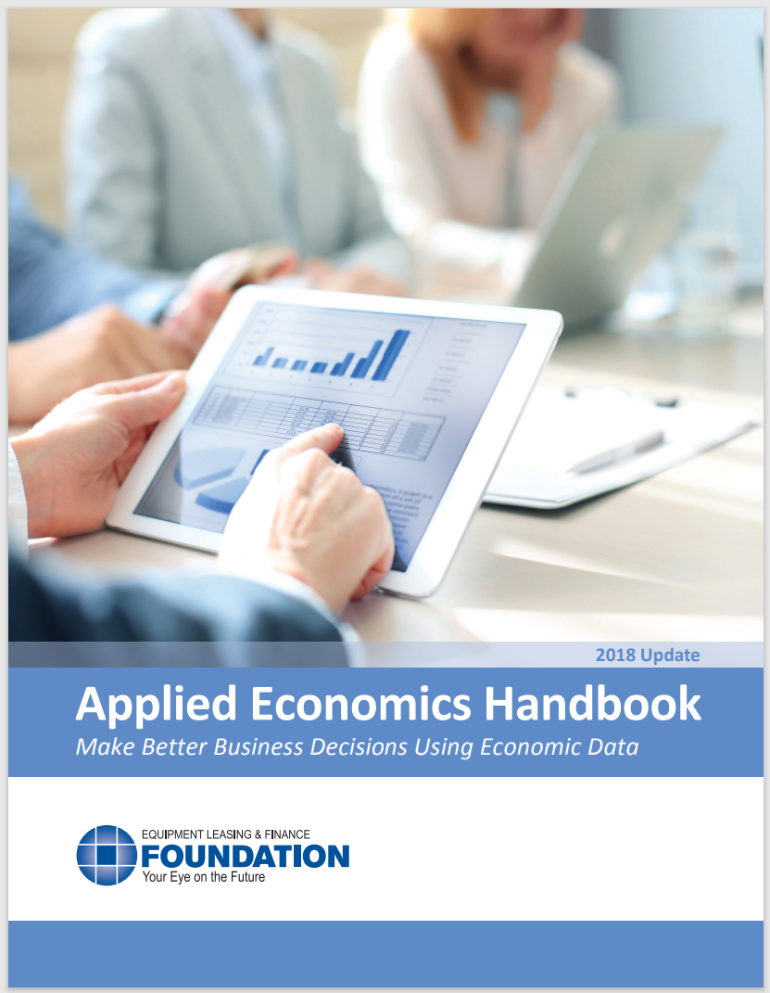
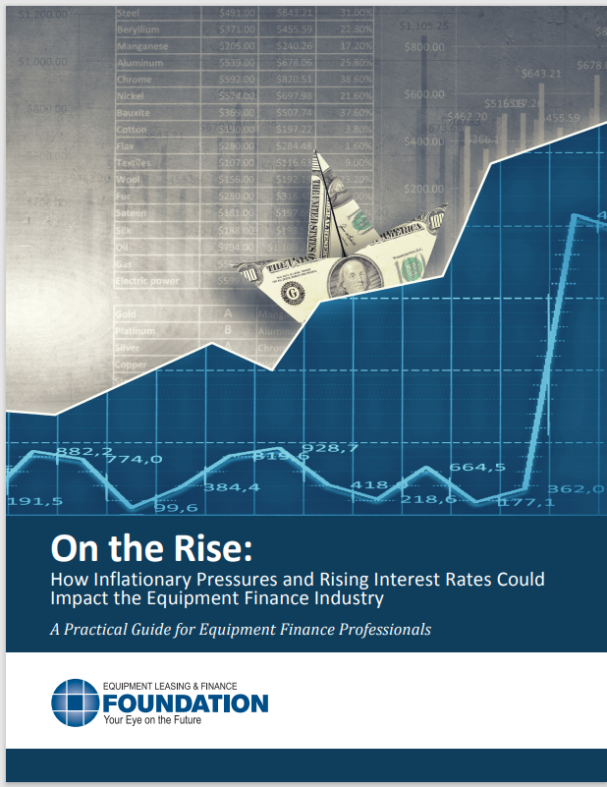
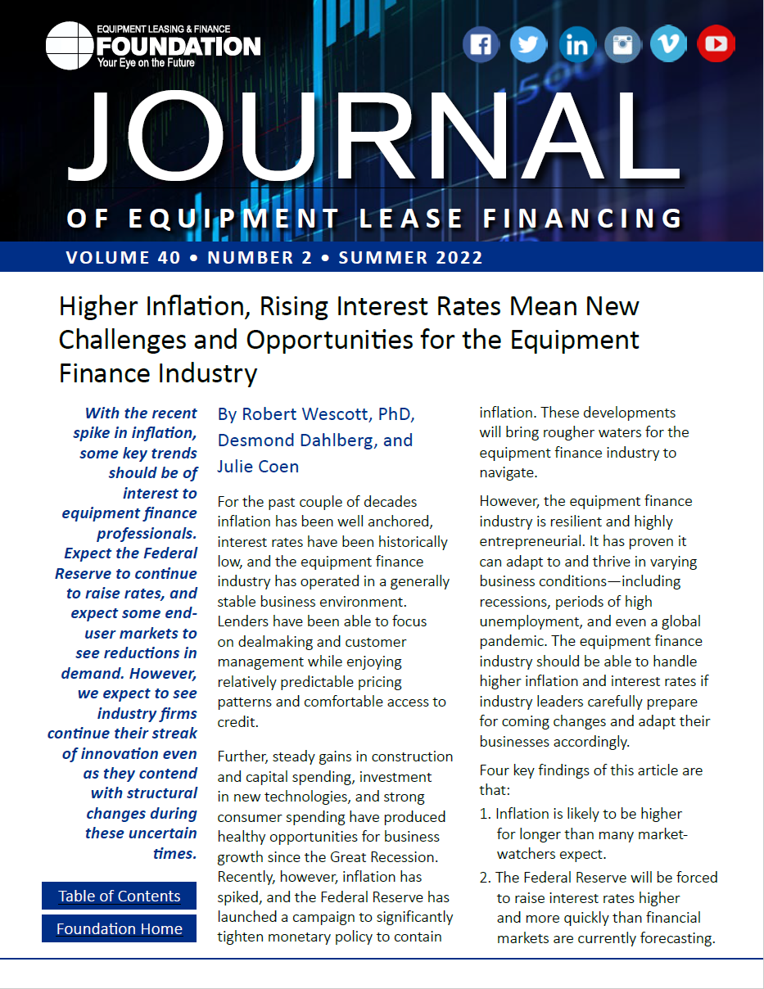
EQUIPMENT LEASING & FINANCE FOUNDATION
For more information, download the Applied Economics Handbook or research articles (2018 & 2022) analyzing the effect of inflation and rising interest rates on the equipment finance industry.
Notes:
Note: the updated Applied Econ Handbook is available for free on the Foundation’s website.

Slide 17
Notes
*U.S. Equipment & Software Investment Momentum Monitor (Slide 11)
Published monthly, the U.S. Equipment & Software Investment Momentum Monitor is a set of leading indicators for the equipment sector consisting of indices for various equipment and software investment verticals. These indices are designed to identify turning points in their respective investment cycles with a ~6-month lead time.
Each index is comprised of between 15 to 20 high-frequency indicators and is statistically optimized to signal turning points in the investment cycle without giving false readings of shifts in momentum.
The Momentum Monitor covers 12 equipment and software verticals as defined by the U.S. Department of Commerce Bureau of Economic Analysis. These verticals include aircraft, agriculture machinery, computers, construction machinery, materials handling equipment, medical equipment, mining and oilfield equipment, other industrial equipment, railroad equipment, ships and boats, software, and trucks.
“Recent Momentum" represents the degree of an indicator's recent acceleration or deceleration in the past month relative to its average movement during the previous 3 months. Ratings closer to "0" represent an indicator that is rapidly decelerating, while ratings closer to “10” represent an indicator that is rapidly accelerating.
"Historical Strength" represents the strength or weakness of an indicator in the past month relative to its typical level since 1999. Ratings closer to "0" represent an indicator that is weaker than average, while ratings closer to "10" represent an indicator that is stronger than average.

