Slide 1


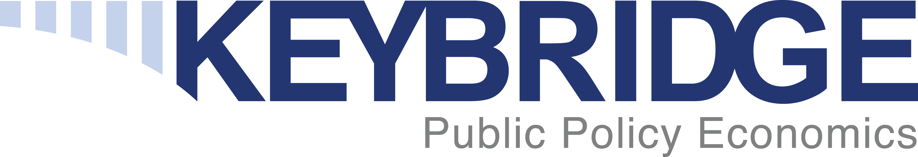
October 2021
Equipment Leasing & Finance Industry Snapshot

Slide 2

Data: Table of Contents
1. Overall Economy
p. 3
2. Investment
p. 8
3. Business Health
p. 11

Slide 3

After expanding at a 6.7% annualized rate in Q2, the economy is now larger than it was prior to the pandemic.
Economy
Real GDP Growth
Annualized Percent Change from Previous Quarter
33.4%
30-Year Quarterly Average = 2.6%
-31.4%
Source: U.S. Bureau of Economic Analysis, Keybridge LLC
Notes:
U.S. GDP rose at a 6.7% annualized rate in Q2 as business restrictions eased, mobility surged, and consumers unleashed spending across goods and services industries.
Growth in the second quarter was driven by a surge in consumer spending and business investment.
Overall, the Foundation projects the U.S. economy will grow by 5.3% in 2021. Growth will likely be driven by strong levels of consumer spending thanks to accumulated savings and business investment by new and recovering firms. However, growth is expected to have slowed substantially in the second half of the year.

Slide 4
Q2 growth was driven by consumer spending and E&S investment. Other investment, along with gov’t spending and exports, dragged down growth.
Economy
Tailwinds & Headwinds
Contributions to GDP Growth by Sector, Q2 2021
Positive
Contributions
[+8.88]
Negative
Contributions
[-2.17]
Net Exports
(-0.18)
E&S Investment
+0.96
Govt Spending
(-0.36)
Other Investment
Consumer Spending
+7.92
GDP Growth
[+6.71]
Source: U.S. Bureau of Economic Analysis, Keybridge LLC
Notes:
Economists often use a simple formula to describe the U.S. economy: “C + I + G + NX” (consumption + investment + government spending + net exports). With this in mind, the primary driver of Q2’s expansion was consumer spending followed by E&S investment. Meanwhile, other investment, government spending, and net exports weighed on GDP growth.
Consumer spending rose by 12% (annualized) in the second quarter of 2021, contributing nearly 8 percentage points to GDP growth. Spending growth was broad-based, with double-digit growth across services, durable goods, and non-durable goods.
Private Investment contracted 3.9% (annualized) in the second quarter, driven by a decline in inventories.
Government spending eased by 2.0% (annualized) in Q2, in part due to some states’ decisions to opt out of federal unemployment insurance programs.
Net exports were a minor drag on growth, subtracting 0.18 point from GDP in Q2.

Slide 5
Top Economic Headwinds & Tailwinds
ECONOMIC TAILWINDS
$
Consumer Financial Cushion
Consumers are on strong financial footing thanks to savings accumulated during the pandemic, suggesting consumers still have more pent-up spending power.
This financial cushion is keeping financial stress low as pandemic-era relief measures like the foreclosure and eviction moratoria expire.
As the economy recovers, there has been a dramatic surge in demand for workers. Labor demand has been particularly strong for in-person services.
However, while hiring has been strong by historical standards, it has fallen short of expectations, and labor force participation remains subdued. One consequence is that many workers are demanding better pay and more flexibility.
Labor Demand
ECONOMIC HEADWINDS
Although consumer mobility improved substantially over the spring and early summer, the Delta variant has reduced in-person retail and recreation activity.
The Delta variant is not expected to impair growth as severely as last winter’s COVID-19 surge. However, a worsening public health situation could lead to more financial stress now that federal support measures have largely expired.
Consumer Mobility Stalls
Supply chains across the world have been disrupted by travel and work restrictions instated due to COVID, especially in East Asian countries.
Port closures and backlogs have been particularly disruptive to supply chains, causing major delays and cancellations that are driving up prices.
Supply Chain Pressures
Source: 2021 Annual Equipment Leasing & Finance U.S. Economic Outlook
Notes:
Tailwinds:
Consumer Financial Cushion
Consumer have amassed significant savings over the pandemic.
Consumers have about $2.3 trillion in pent-up spending power thanks foregone spending during the pandemic and government support (e.g., stimulus checks, UI programs).
This financial cushion is keeping consumers afloat as federal provisions like the eviction and foreclosure moratoria expire. Although Black Knight reports that 1.6 million borrowers are mortgage forbearance programs, economists do not expect a wave of foreclosures.
Labor Demand
Historic demand for workers and relatively low levels of hiring are leading workers to negotiate better pay and working conditions.
In July, job openings hit a series high of 10.9 million, per the Bureau of Labor Statistics. Though this reading eased slightly in August, hiring demand remains particularly strong for in-person services and among small businesses.
Per BLS, average weekly earnings for private nonfarm workers increased by 4.6% on an annual basis in September. By comparison, average weekly earnings were growing at around 3% Y/Y prior to the pandemic.
Headwinds:
Consumer Mobility Stalls
Consumer mobility nearly recovered fully over the summer. However, the pandemic’s resurgence has reduced consumers from in-person shopping and recreating, per Google.
TSA passenger volume had risen to a pandemic-era high earlier in the summer but fell again as the Delta variant spread.
Reduced mobility had translated to weaker spending according to BEA’s weekly consumer spending estimates.
However, the Delta variant is not expected to depress mobility and spending as much as the virus did last winter.
Per Opportunity Insights, consumer spending remains more than 15% above the pre-pandemic baseline.
Visa expects U.S. consumer spending to expand at its fastest pace in years.
Consumer financial stress may increase if the public health situation worsens and spending weakness in certain sectors spreads to the rest of the economy.
Supply Chain Pressures
Various sectors of the economy are being impacted by supply chain disruptions.
Many East Asian countries have low vaccination rates that are leading to lockdowns, which are in turn disrupting supply chains and driving up prices.
Supply chains are also being snarled by port closures, leading to increased cargo ship congestion in U.S. ports.

Slide 6
Additional Factors to Watch
Fiscal Policy Uncertainty
Congress has been engaged in debates on various spending and budget items that carry serious economic, financial, and geopolitical consequences.
While Congress has avoided a potential partial shutdown and breach of the debt ceiling for now, both measures are temporary and will have to be addressed again later this year.
Meanwhile, Democrats continue to debate among one another how to pass an infrastructure bill and large social spending bill. Both bills carry sizeable price tags, but also have the potential to boost future growth.
1
Inflation Concerns
Concerns about persistently high inflation have intensified. Consumers are reporting historically high inflation expectations and a significant share of businesses have been raising prices.
An unprecedented level of federal payments, along with a tight labor market and supply chain bottlenecks, are combining to put significant upward pressure on prices. Economists are split on whether these price increases will subside over the next six months or will persist for longer.
2
Source: 2021 Annual Equipment Leasing & Finance U.S. Economic Outlook
Notes:
Additional Factors to Watch
Fiscal Policy Uncertainty
Congress averted two potential crises in October.
By passing a stopgap spending bill that expires in December, Congress avoided a partial government shutdown.
A bipartisan group of senators passed a bill that raised the federal debt limit to ensure the federal government would not default in mid-October.
However, both measures are temporary and will have to be addressed again later this year.
Meanwhile, Democrats have been discussing the best approach to passing an infrastructure bill and social spending bill, both of which come with hefty price tags but could boost economic growth in 2022 and beyond.
Inflationary Concerns
Consumers are reporting high inflation expectations.
Per the NY Fed, the median one-year ahead expected rate of inflation was 5.2%, while the median three-year ahead rate was 4.0% — both series highs, and well above the Fed’s 2% target.
Indeed, per the NFIB, the net share of Main Street businesses that raised prices over the last three months rose to 49% in August, the highest share since the 1980s.
Prices have risen globally due to higher energy and food prices, shipping costs, labor constraints, and supply chain bottlenecks. If such economic disruptions persist, higher inflation could linger well into next year.

Slide 7
Additional Factors to Watch
Pandemic Trajectory
Although the Delta variant has caused some “breakthrough” COVID-19 infections, vaccines have been very successful in limiting serious COVID-related illnesses and deaths among the fully vaccinated
The combination of an overall vaccination rate approaching 60% and some level of natural immunity among those recently infected may prevent or limit the impact a new wave this winter. However, if another surge does occur, it would negatively affect consumer confidence and economic activity.
3
Monetary Policy
Inflation concerns and financial market gains have led Fed watchers to expect a slow return to tighter monetary policy conditions (e.g., “tapering” of asset purchases) later this year.
This prediction comes during a volatile time for financial markets, which is largely caused by substantial weakness in the Chinese housing sector and equity markets. This could have consequences for stock prices, business confidence, and consumer sentiment.
4
Source: 2021 Annual Equipment Leasing & Finance U.S. Economic Outlook
Notes:
Additional Factors to Watch
Pandemic Trajectory
Around two-thirds of Americans have received at least one vaccine dose, and that share continues to rise slowly. This has succeeded in limiting serious illness and death in the fully vaccinated population and has helped the economic rebound.
However, it remains unclear whether a new wave is around the corner. Several factors could contribute to increased spread of the virus.
Colder weather leads to more indoor activity and increased risk of transmission.
Most schools have returned to in-person activity, increasing exposure for some families until vaccines for children under 12 are available.
Policymakers are reluctant to reimpose operating restrictions in many parts of the country.
Heightened mobility compared to last winter increases the rate of transmission.
A new wave could depress consumer confidence and spending.
Monetary Policy
Fed watchers are expecting slow tightening of monetary policy thanks to inflation concerns and financial market excess.
The Fed could start “tapering” its asset purchases soon.
Financial markets have seen some of the frothiest valuations in history in recent months. For example, the Shiller Cyclically Adjusted Price-Earnings Ratio currently sits at its highest level (38), since the Dot-Com Bubble.
Financial markets are particularly volatile thanks to weakness in the Chinese housing sector and debt markets.
There is risk of an equity market shock should the situation in China deteriorate further, which would have negative impacts on business confidence and consumer sentiment.

Slide 8
Projections for Key Economic Indicators
Indicator | 2019 | 2020 | 2021 Quarterly Estimates |  |  |  | 2021e
 |  |  | Q1e | Q2e | Q3e | Q4e
Real GDP (SAAR %) | 2.2% | -3.5% | 6.3% | 6.7% | 1.5% | 2.5% | 5.3%
Real Investment in Equipment & Software (SAAR %) | 3.5% | -2.1% | 17.6% | 12.7% | 2.0% | 3.0% | 13.2%
Inflation (year-on-year %) | 1.8% | 1.2% | 1.9% | 4.8% | 5.3% | 4.7% | 4.2%
Federal Funds Target Rate (upper bound, end of period) | 1.75% | 0.25% | 0.25% | 0.25% | 0.25% | 0.25% | 0.25%
Total Payroll Growth (thousands) | 2,011 | -9,416 | 1,554 | 1,845 | 1,651 | 1,500 | 6,500
Source: 2021 Q3 Equipment Leasing & Finance U.S. Economic Outlook
Notes:
GDP: We expect GDP growth to accelerate to 5.3%, driven by high consumer spending and increased inflation.
Investment: After surging for the last two quarters, we expect investment to slow down for the rest of the year thanks to substantial supply chain issues and easing confidence.
Inflation: Since Q1, inflation has risen sharply due to supply chain disruptions, labor shortages, and rising input costs.
Interest Rates: Despite rising inflation, the Federal Reserve has maintained it will keep rates unchanged until late 2022 or early 2023, when the labor market is expected to have recovered.
Job Growth: After accelerating earlier this summer, job growth has slowed significantly despite the expiration of federal UI programs and most states being “fully open.” This suggests some workers may be hesitant to take up jobs for other reasons (e.g., health concerns, childcare constraints).

Slide 9
Business investment expanded in Q2 2021 for the fourth consecutive quarter. Q3 growth is expected to have been substantially weaker than the first half of the year.
Investment
Business Investment
Real Nonresidential Fixed Investment, Percent Change from Previous Quarter (SAAR)
9.2%
-30.3%
Source: U.S. Bureau of Economic Analysis
Notes:
Business investment expanded 9.2% (annualized) in Q2 after rising 12.9% in the previous quarter.
Business investment (also known as nonresidential fixed investment) consists of three elements: equipment, software and R&D, and non-residential structures (e.g., commercial buildings, oil platforms).
Equipment: +12.1% (annualized) (down from +14.1% in Q1)
Software and R&D: +12.5% (annualized) (down from +15.6% in Q1)
Non-residential structures: -3.0% (annualized) (down from +5.4% in Q1)

Slide 10
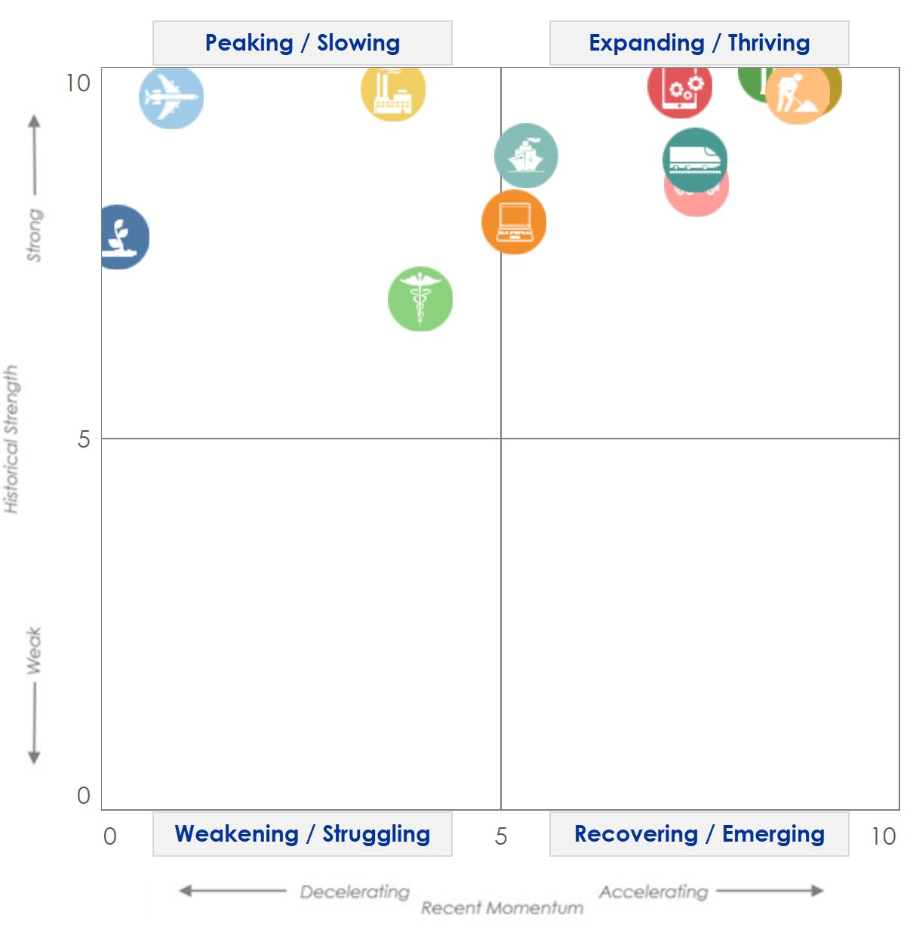
Nine verticals saw investment rise in the second quarter, including Construction Machinery and Mining & Oilfield.
Investment
Equipment & Software Investment
Momentum Monitor (Equipment Vertical Performance Matrix)
Source: 2021 Q3 Equipment Leasing & Finance U.S. Economic Outlook
For more information on how to use the Momentum Monitors, see final slide.
Notes:
Equipment and software investment surged in Q2, after a similarly strong expansions in the last three quarters. E&S investment growth will likely slow, though remain positive throughout the rest of 2021.
Based on the latest data, the following equipment verticals show potential promise in the next 3-6 months:
Aircraft
Railroad
Construction
Trucks
Software
Mining & Oilfield
Computer
Ships & Boats
The following equipment verticals may peak in the next 3-6 months:
Agriculture
Medical
Aircraft
Industrial
Notes about the Equipment Vertical Performance Matrix: The matrix above summarizes the current values of each of the 12 Equipment & Software Investment Momentum Indices based on two factors: Recent Momentum (x-axis) and Historical Strength (y-axis). The matrix is comprised of four quadrants according to each vertical’s “recent momentum” and “historical strength” readings (see last slide in deck for a description of these terms):
If a vertical is located in the top-left quadrant, its momentum reading is higher than average, but positive movement has slowed (and perhaps reversed) in recent months — suggesting that investment levels may fall over the next 1-2 quarters.
Verticals located in the bottom-right quadrant, however, have momentum readings that are below average, but recent movement shows promise — suggesting that investment levels may rise over the next 1-2 quarters. This makes them potentially attractive targets for new leasing and finance opportunities.

Slide 11
Equipment and software investment is projected to expand by a robust 13.2% in 2021, the strongest year in a decade — though most of that growth likely occurred during the first half of the year.
Investment
Real Equipment & Software Investment Growth
Q/Q Percent Change, SAAR
Forecasts
Source: U.S. Bureau of Economic Analysis; Projections from Keybridge
Notes:
The Foundation expects equipment and software investment to grow at an 13.2% pace (annualized) in 2021, a strong recovery from last year’s pandemic recession.

Slide 12
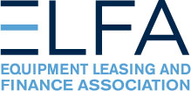
After posting a strong reading in Q1, new business volume and business investment continued to accelerate this summer.
Bus. Health
Through August*, new business volume was up 10.3% relative to 2020 levels
MLFI-25 New Business Volume
Billion Dollars
Note: The MLFI-25 reflects input from 25 equipment finance companies and thus does not represent the total size of the industry.
Source: ELFA MLFI-25
*Note: The MLFI-25 reports economic activity from 25 companies representing a cross section of the equipment finance sector. It does not represent the total size of the equipment finance industry.
Notes:
According to ELFA’s Monthly Leasing and Finance Index, new business volume expanded 21% year-over-year in August. Strong business investment are expected to keep new business volume elevated through the rest of the year, though Y/Y growth may ease somewhat.
*Note: ELFA's Monthly Leasing and Finance Index (MLFI-25) reports economic activity from 25 companies representing a cross section of the equipment finance sector.

Slide 13
In August, new business volume surged at a 21% annual pace, reflecting both a strong recovery and weaker activity last year.
Bus. Health
MLFI-25 New Business Volume
Y/Y Percent Change
21%
Source: ELFA MLFI-25
Notes:
On an annual basis (i.e., compared to growth experienced in August 2020), new business volume rose 21% in August, the fourth month of double-digit investment growth since the pandemic began.

Slide 14
Industry leaders are less confident about the industry’s near-term trajectory than they were earlier this year — though the index’s reading is still strong by historical standards.
Bus. Health
Monthly Confidence Index: Equipment Finance Industry (MCI-EFI)
60.5
Source: ELFF MCI-EFI
Notes:
Confidence among equipment industry executives fell 6.1 points to 60.5 in September. The metric has plunged to the lowest level since January.
In September, 18% of respondents expected business conditions to improve over the next fourth months, down sharply from 36% in August. Meanwhile, 3.6% respondents expect business conditions to worsen, the first time anyone has reported expectations of worsening conditions since April.
29% expect to hire more employees over the next four months, down from 36% in August. No respondents expects to hire fewer employees.
Note: The MCI-EFI is produced by ELFF each month using a survey of key industry executives from banks, captives, and independent firms. It is designed to provide a qualitative assessment of both the prevailing business conditions and expectations for the future.

Slide 15
The Equifax Small Business Lending Index fell 3.2 points in August, though the three-month moving average remains 6% above its year-ago level.
Bus. Health
Equifax Small Business Lending Index (SBLI)
January 2005 = 100
SBLI
142.8
SBLI 3MMA
Source: Equifax
Notes:
Equifax’s Small Business Lending Index (“SBLI”) fell 3.2 points to 142.8 in August but is 8.3% higher than a year ago. Meanwhile, the SBLI 3MMA edged down 0.3% in August but remains historically elevated.
Small firms have seen a slowdown in economic activity over the summer, largely due to the Delta variant. While business prospects for the rest of the year will depend on the containment of COVID-19 infections, a protracted small business downturn like that seen last year seems unlikely at present.

Slide 16
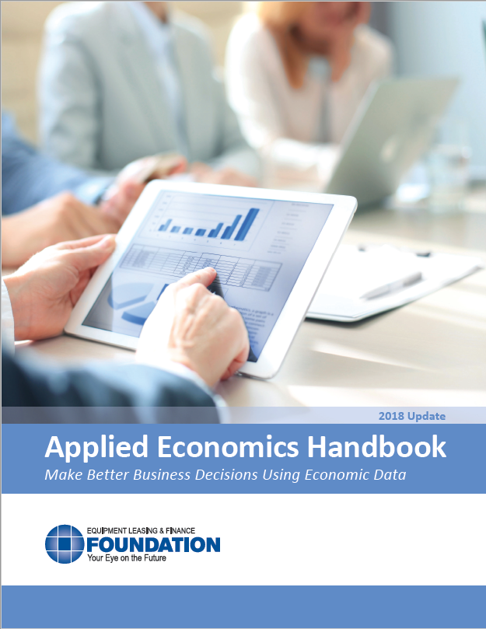
EQUIPMENT LEASING & FINANCE FOUNDATION
For more information on how you can use this information in your business, download the Applied Economics Handbook.
Reports are available to download at www.store.leasefoundation.org
Notes:
Note: the recently-updated Applied Econ Handbook is available for free on the Foundation’s website.

Slide 17
Notes
*U.S. Equipment & Software Investment Momentum Monitor (Slide 9)
Published monthly, the U.S. Equipment & Software Investment Momentum Monitor is a set of leading indicators for the equipment sector consisting of indices for various equipment and software investment verticals. These indices are designed to identify turning points in their respective investment cycles with a 3–6-month lead time.
Each index is comprised of between 15 to 20 high-frequency indicators and is statistically optimized to signal turning points in the investment cycle without giving false readings of shifts in momentum.
The Momentum Monitor covers 12 equipment and software verticals as defined by the U.S. Department of Commerce Bureau of Economic Analysis. These verticals include aircraft, agriculture machinery, computers, construction machinery, materials handling equipment, medical equipment, mining and oilfield equipment, other industrial equipment, railroad equipment, ships and boats, software, and trucks.
“Recent Momentum" represents the degree of an indicator's recent acceleration or deceleration in the past month relative to its average movement during the previous 3 months. Ratings closer to "0" represent an indicator that is rapidly decelerating, while ratings closer to “10” represent an indicator that is rapidly accelerating.
"Historical Strength" represents the strength or weakness of an indicator in the past month relative to its typical level since 1999. Ratings closer to "0" represent an indicator that is weaker than average, while ratings closer to "10" represent an indicator that is stronger than average.

