Slide 1
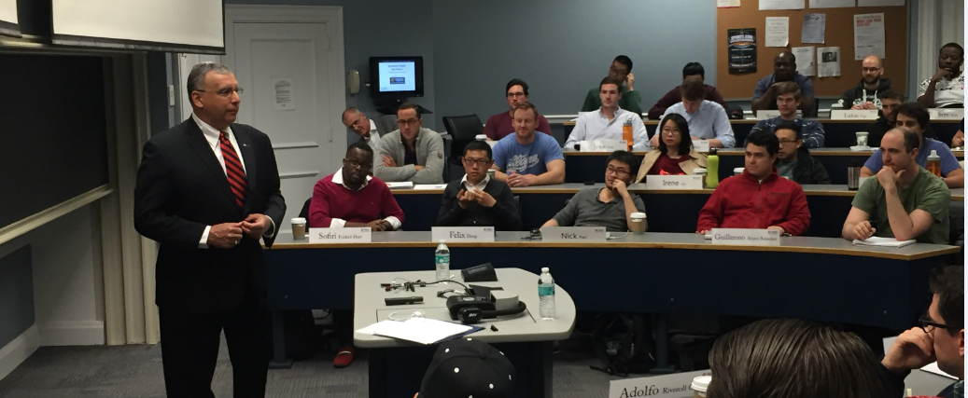
Equipment Leasing and Finance:
A Dynamic, Global Industry

Slide 2
Presenter Info
Name
Title
Organization
URL
logo

Slide 3
Agenda
Industry Overview
Who Uses Equipment Finance and Why?
Capital Markets
Career Paths
Q&A

Slide 4
Equipment Leasing and Finance
Industry Overview

Slide 5
Industry Overview
Most businesses require equipment in order to operate and grow and, for a majority of businesses, equipment financing is a key acquisition strategy.
Domestically, equipment finance accounts for $1 trillion of business each year.
Each year American businesses, nonprofits and government agencies invest over $1.584 trillion in capital goods and software (excluding real estate).
Some 67%, or $1 trillion, is financed through loans, leases and other financial instruments.
Nearly 8 in 10 businesses use at least one form of financing (excluding credit cards) to acquire equipment.

Slide 6
Industry Overview
The key aspect to understand about equipment finance is that it is one of the most important ways for businesses to invest in capital while managing their balance sheets, taxes and cash flow.

Slide 7
Industry Overview
The equipment finance market is poised for a period of modest, but steady growth.

Slide 8
Industry Overview
The assets that a business may need to finance are varied; examples include:
Agricultural equipment
Commercial and corporate aircraft
Manufacturing and mining machinery
Rail cars and rolling stock
Vessels and containers
Trucks and transportation equipment
Construction and off-road equipment
Business, retail and office equipment
Medical technology and equipment
IT equipment and software

Slide 9
Industry Overview
Who are the players?
Banks | Banks finance the sale or lease of equipment. Banks may offer lease financing as one of their financial products in order to provide their customers with a full range of financial services.
Captives | Captives are companies set up by a manufacturer or equipment dealer to finance the sale or lease of its own products to end-users.
Independents | An independent leasing company is one that is not affiliated with another company. Independent leasing companies vary greatly in the products and services they offer. They may be generalists or they may specialize by ticket size, by equipment type, or by other criteria.
Brokers | Brokers establish a relationship with the CFO, assess their equipment financing need, and help determine the best product and structure to meet this need. The Broker then presents the deal to several sources to find the best funding partner. Brokers earns fees for services from either Company or the Funding Source.

Slide 10
Industry Overview

Slide 11
Industry Overview
Entrepreneurs are prevalent, and many have had successful exits.
First American acquired by City National Bank
Tygris Commercial Finance acquired by Everbank
ILFC acquired by AIG
McCue acquired by NetSol
Capital Stream acquired by HCL

Slide 12
Industry Overview
Entrepreneurs have started successful leasing companies.
Allegiant
Boston Financial
Cole Taylor
GreatAmerica

Slide 13
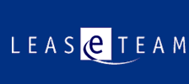
Industry Overview
Entrepreneurs have started successful software and consulting firms.
ALFA
The Alta Group
International Decision Systems
Ivory Consulting
LeaseTeam
PayNet

Slide 14
Industry Overview
Technology
Technology/Medical Equipment Manufacturing Captives
Software & Technology Suppliers
Canon Financial Services
Cisco Systems Capital
Dell Financial Services
IBM Global Financing
Lenovo Global Financial Services
Oracle/Sun Microsystems
Siemens
ALFA
Cassiopae Inc.
International Decision Systems
Ivory Consulting
LeaseTeam
NetSol
Odessa
Oracle

Slide 15
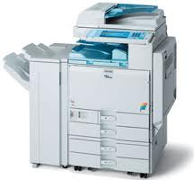
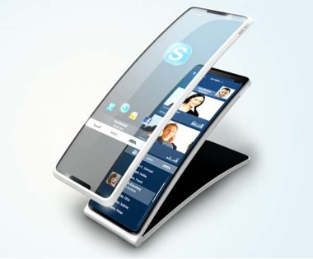
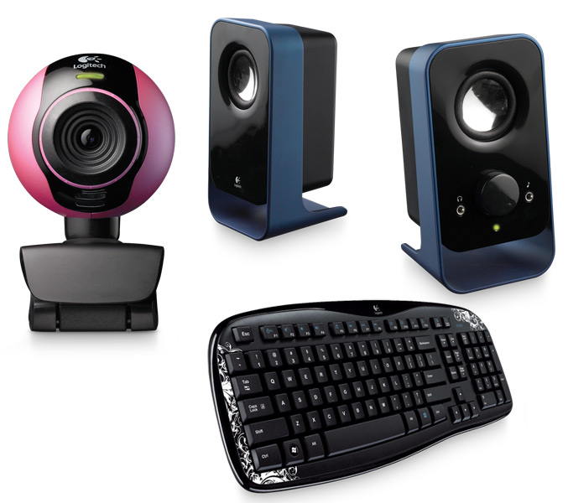
Industry Overview
Market Segments – Small-Ticket Financing
A market segment generally represented by transactions under $250,000.
Equipment in this segment includes such items as computer peripherals, office equipment, services, software and telephone equipment.

Slide 16
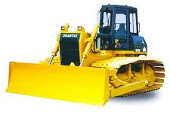
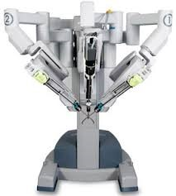
Industry Overview
Market Segments – Middle Market Financing
A market segment generally represented by transactions between $250,000 and $5,000,000.
Equipment in this segment includes solar equipment, computers, software, services, enterprise networks, manufacturing equipment, health services, construction equipment and medical equipment.

Slide 17
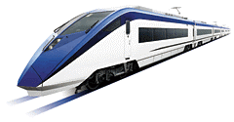
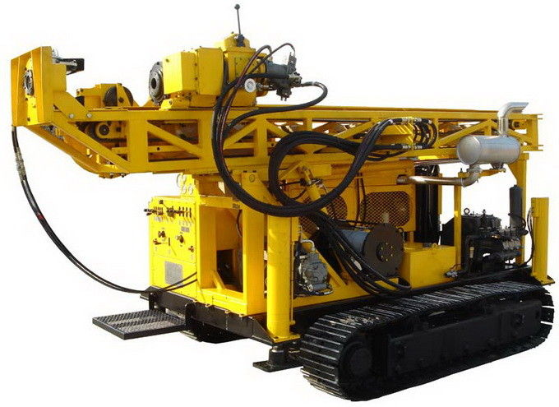
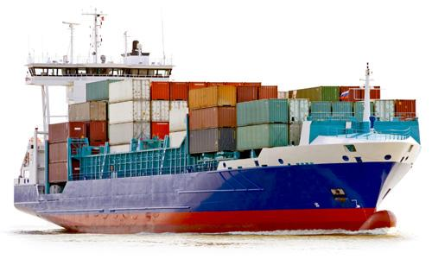
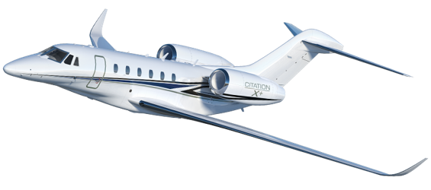
Industry Overview
Market Segments – Big-Ticket/Large-Ticket Financing
A market segment generally represented by financing that usually exceeds $5,000,000.
Equipment financed in this segment includes power plants, railroad equipment, helicopters, commercial and corporate jets, vessels and other transportation equipment, and large mining, and oil and gas exploration.

Slide 18
Why Equipment Finance?

Slide 19
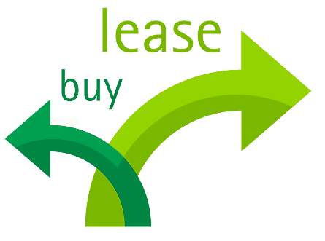
Why Equipment Finance?
Secured Lending and Lease Financing
A loan is a financing agreement that allows a business to acquire, use and own equipment.
- A loan may require a down payment or a pledge of other assets for collateral. Under a loan financing, the borrower remains the owner of the equipment for tax and accounting purposes.
A lease allows a company to acquire and use equipment while conserving its cash flow and lines of credit.
- Leasing also provides a new source of credit with the added benefit of being able to expense your lease payments in most instances. Leasing also can protect against equipment obsolescence when upgrades are included in a lease contract or the equipment is returned to the lessor at the end of the lease term.

Slide 20
Why Equipment Finance?
There are countless reasons why it’s a smart idea to use equipment leasing and finance.
Conservation of cash
100% financing
Preservation of capital
Hedge against inflation
Improved expense planning and business-cycle flexibility
Regular technology updates
Tax considerations
Relationship with equipment experts
Obsolescence management
Product and service bundling
Equipment Disposal
For more information, go to:
www.equipmentfinanceadvantage.org

Slide 21
Capital Markets

Slide 22
Capital Markets Activity
Guest Lecture Program
Capital markets activity plays an important role in the equipment finance industry.
Capital markets activity is any type of external funding required to operate an equipment leasing company.
Capital markets activity includes:
Asset Securitization – Public Issuances and Rule 144A Private Placement Offerings
Syndication – Syndicate a newly originated equipment lease or loan in whole, or in part via Participation Agreement.
Portfolio Sale Type Activity – This could represent a pool of similar type transactions or one-off transactions

Slide 23
Capital Markets Guest Lecture Program
Equipment-Based Asset Securitization
Asset securitization allows for “wholesale institutional” type funding by pooling a number of individual loans with diverse characteristics in terms of geography, customer concentration, asset type and industry diversity.
Classes of bonds are issued with varying degrees of risk (A,B,C); higher risk means higher rates, and are often times rated by S&P, Moody’s, and Fitch to increase potential pool of buyers.
Payments on underlying loans provide cash flow to service bond payments. The issuer absorbs a first loss position, and excess cash is built up during term – added protection.

Slide 24
Capital Markets Guest Lecture Program
Syndications
Syndications: Participations of financial institutions in a sale and/or assignment of all or part of an underlying lease or loan transaction.
Larger equipment financing companies maintain a buy and sell desk. Large equipment leases or loans may require a syndication strategy to meet the customer’s needs and bank’s credit requirements
Example: ABC Bank Lessor originated an $80 million lease for 1,800 used railcars. They approve a hold position of $40 million on this company; syndicate $40 million to 3rd party investors.
Customer Benefits: Deal with a single lessor, negotiate 1 set of docs; and 1 servicer.
Benefits to Syndicator: Manage credit exposure, fee income, market intelligence.
Allocation: Investor is allocated specific assets but tied to the same lease. If financing is for one large asset that can’t be divided (a large aircraft), a Participation Agreement is created.

Slide 25
Capital Markets
Portfolio Sale Type Activity
A leasing company can use portfolio sales (in bulk or one-off) to manage the earnings stream or risk characteristics of their portfolio.
May have desire to decrease (or exit completely) their exposure to certain credits, industries, asset types or geographies. Portfolio sale efficiently accomplishes goal.
If equipment value increases during term, a new lessor may be able to assume a higher residual and a sale of the lease results in an immediate gain.
Examples:
You booked a deal years ago for a weak credit at a high spread, and the credit has improved and the spreads compressed. Deal can be sold at a big gain.
A leasing company has $20 million in exposure to Company A and is awarded a new $10 million lease from Company A. Rather than sell the new deal, it may be more profitable to syndicate the lease in the portfolio.

Slide 26
Career Paths in Equipment Finance

Slide 27
Career Paths
Equipment Finance Lessors
Executive/Entrepreneur – Corporate leaders and entrepreneurs who set the vision and lead its execution for leasing/lending organizations in banks, manufacture’s or independent entities.
Economics/Capital Markets – Provide value-added pricing and economic analysis support by keeping up on developments in the accounting, tax and regulatory environment as well as following market conditions.
Credit – Includes underwriters who understand the risk dynamics in the equipment leasing and finance industry. Credit employees conduct deal analysis yet wear a business hat. Typically have a macro view of the economy.
Asset Management – Deep knowledge of equipment assets and customer requirements. Brokerage capability to place equipment in to secondary markets.
Relationship Manager – Sell lease and loan financing solutions to meet customer equipment financing needs. RMs coordinate the credit approval and documentation process to meet client expectations. Compensation is typically tied to results with commissions paid on funded volume.

Slide 28
Career Paths
Equipment Finance Suppliers
Capital Agent – Raises capital and funds leasing and lending companies.
Software Executive/Entrepreneur – Includes CRM, ERP, originations, pricing, credit analysis and BI software companies, many founded to serve the lending and leasing industry.
Consultants -- Consulting organizations have a presence in the secured lending and leasing finance industry.
The Alta Group
Capgemini
Deloitte
GenPact
McKinsey & Company

Slide 29
Getting to Know the Foundation
The Equipment Leasing & Finance Foundation is a 501(c)3 nonprofit organization established by ELFA in 1989.
Our mission is to inspire thoughtful innovation and contribute to the betterment of the equipment leasing and finance industry.
The Foundation has published several hundred industry research studies, publications and articles including:
Journal of Equipment Lease Financing
Monthly Confidence Index(MCI)
Industry Future Council
State of the Equipment Finance Industry report (SEFI)
Annual U.S. Economic Outlook report series (Updated Quarterly)
The Foundation is supported 100% by charitable donations
Over $650,000 raised in 2016 from corporate and individual contributions
Donor benefits include early release of research and recognition during ELFA events
For more information visit
www.leasefoundation.org

Slide 30
Getting to Know the Association
The Equipment Leasing and Finance Association (ELFA) is the trade association representing financial services companies and manufacturers in the $1 trillion U.S. equipment finance sector
ELFA’s mission is to provide member companies with:
A platform to promote and advocate for the industry
A forum for professional development and training
A resource that develops information about and for the industry
For comprehensive information and resources about the equipment leasing and finance industry, go to:
www.elfaonline.org
For end-user information, go to:
www.EquipmentFinanceAdvantage.org

Slide 31
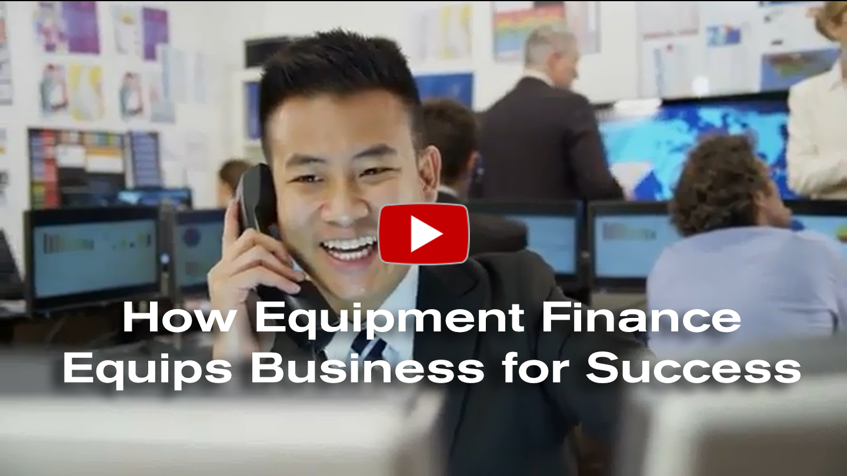
Learn More
Watch the Video at www.equipmentfinanceadvantage.org/value

Slide 32
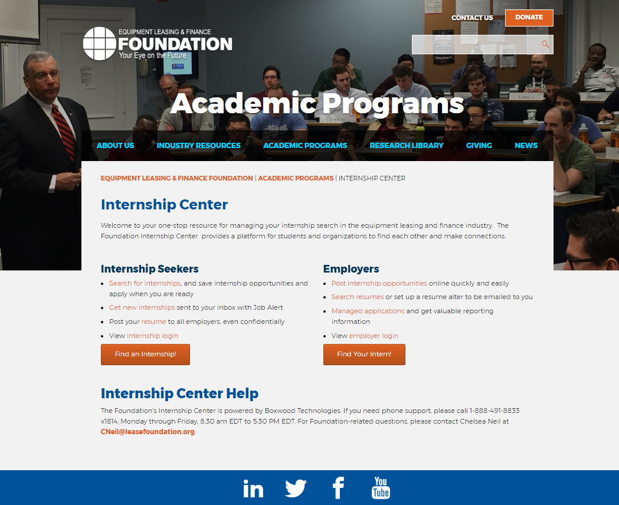
Looking For an Internship?
The Internship Center is a one stop resource for finding an internship in the equipment finance industry.
Search for internships
Post your resume
And get new internship opportunities sent directly into your inbox
To get your internship search started, visit:
https://www.leasefoundation.org/academic-programs/internship-resources/

Slide 33
Questions?

Slide 34
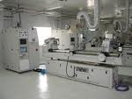
Why Equipment Finance?
The Benefits of Equipment Finance
INCOME TAX
Alternative Minimum Tax issues
Deduct 100% of Lease Payments
Loss carry forwards
Avoid 4th quarter 40% rule
CASH FLOW
Conserve cash for acquisitions
Match payments to seasonality
Sale/lease back to generate cash
Lowest monthly payment with minimal
outlay
EQUIPMENT
Prefers to use equipment vs. ownership
risks
Trade up to avoid obsolescence
Reduce cash requirements during life
BALANCE SHEET
Industrial revenue bond covenants
Comply with key ratios from lenders
Measured for performance by ROA/ROE

Slide 35
Why Equipment Finance?
There are two basic types of leases
Tax Oriented Lease – The provider of the lease financing (the Lessor) purchases the equipment and is the owner of the equipment for tax purposes. The Lessor is entitled to the tax benefits of ownership (depreciation) and as a result can offer a lower rate to the company (Lessee).
Non-Tax Oriented (Capital) Lease – The Lessor provides 100% financing but the tax ownership remains with the Lessee

Slide 36
Why Equipment Finance?
Lease Structures
Lease Structures
Tax Oriented:
FMV: Capital and Operating
Terminal Rental Adjustment Clause (TRAC): Trucks, Tractors, Trailers
Split-TRAC: Operating Lease treatment (lessee guarantees part of residual position)
Non-Tax Oriented Capital Lease
Synthetic Lease Structures
Lease Line Approvals
Loans
Senior Term Debt
Finance Options
New and Used Equipment
Fixed or Floating Rate Options
Sale and Leaseback

Slide 37
Lease vs. Loan Analysis Assumptions
Lease/Loan Terms: | 7 year; monthly payments in arrears
Funding Date: | Assumed July 15, 2016
Tax Depreciation: | 7 year MACRS (pricing shown with and without 50% bonus depr)
EBO (Lease): | Single fixed price early buyout option (EBO) option 12 months prior to end of lease term
End of Lease Options
Purchase for Fair Market Value
Renew lease at Fair Rental Value
Return equipment to the Lessor
Loan Assumptions: Assumes 100% financing; fully amortizing over the term

Slide 38
7 Year Term Economic Analysis
Product | Monthly Payment (% of Equipment Cost) | Full Term Implicit Rate | Fixed EBO Amount- 6 yrs | Implicit Rate to the EBO
Loan | 1.358152% | 3.81% | N/A | N/A
Lease (w/50% bonus) | 1.104986% | -2.08% | $332,487 (33.25%) | 3.13%
Lease (w/o 50% bonus) | 1.128544% | -1.49% | $335,731 (33.57%) | 3.61%

Slide 39
7 Year Term Accounting Analysis
 | Loan Expense
Year | Interest | Depreciation | Total Loan Expense | Lease Expense *
2012 | $15,543.54 | $59,523.81 | $75,067.35 | $56,427.20
2013 | $33,865.79 | $142,857.14 | $176,722.93 | $135,425.29
2014 | $28,859.79 | $142,857.14 | $171,716.93 | $ 135,425.29
2015 | $23,659.69 | $142,857.14 | $166,516.83 | $ 135,425.29
2016 | $18,257.97 | $142,857.14 | $161,115.12 | $ 135,425.29
2017 | $12,646.82 | $142,857.14 | $155,503.96 | $ 135,425.29
2018 | $6,818.11 | $142,857.14 | $149,675.25 | $ 135,425.29
2019 | $1,195.99 | $83,333.33 | $84,529.32 | $78,998.08
* - Straight Line Lease Expense is allowed for operating leasing under current and proposed ASC 842 lease accounting. Assumes no bonus depreciation.

Slide 40
Other Considerations
Current and future Tax positions
Anticipated Equipment acquisitions
AMT
Loss Carry Forwards
Financing Caps under Credit Facilities
Lease benefit will be more significant for assets with shorter MACRS
Operational flexibility/return options under lease financing
Changes in accounting rules expected to be effective in 2019
Operating leases on balance sheet as an asset and no=debt liability
Operating leases retain straight line expense on P&L

Slide 41
Basics of Tax and Accounting

Slide 42
Tax
Who gets the tax benefits from equipment?
Is the transaction a true lease (also called a tax lease)?
or
Is it a conditional sales lease (also called a non- tax lease)?

Slide 43
Tax
True Lease
Allows the lessor to use the tax benefits of ownership, including tax depreciation
Allows the lessee to expense rental payments
Conditional Sales Lease – An agreement financing the sale of the equipment that:
Allows the lessee to receive the tax depreciation from the equipment
Allows the lessee to deduct the portion of rental payments considered as interest expense.

Slide 44
Accounting
The major question regarding the proposed new rules focuses on the lessee.
What is the impact of capitalizing leases on lessee’s financial statements?
Finance Lease
In a finance lease, the asset is called “finance lease right of use assets” and the liability, or capitalized rent payments, is called “finance lease liability” (classified as debt). The lease costs are front ended comprised of imputed interest expense and asset amortization.
Operating Lease
In an operating lease (a lease that fails to meet the *ASC 842 criteria to be a finance lease) the capitalized value (PV of the payments) is presented as “operating lease right of use assets” and “operating lease liability” (classified as a non-debt liability). The lease cost is straight line average rent expense.
Finance and operating lease assets and liabilities must be broken out either on the balance sheet or in the footnotes.
*Accounting Standards Codification (ASC) Section 842 – under the new FASB codification, ASC 842 is the section that covers lease accounting rules (replacing FAS 13).

Slide 45
Accounting
ASC 842: Finance vs. Operating Leases
 | Finance Lease (at least one of the 5 criteria must be met) | Operating Lease (all 4 criteria must be failed)
Automatic transfer of ownership at end of term | Yes | No
Bargain purchase option | Yes | No
Term | Major part (≥ 75% ) of useful life | Major part (≥ 75% ) of useful life
Present value of rentals using the Incremental Borrowing Rate or the Implicit Lease Rate | Substantially all (≥ 90%) of equipment cost/fair value | Substantially all (≥ 90%) of equipment cost/fair value
Asset is specialized with no alternative use to the lessor | Yes | No

